Slide 1


Slide 2
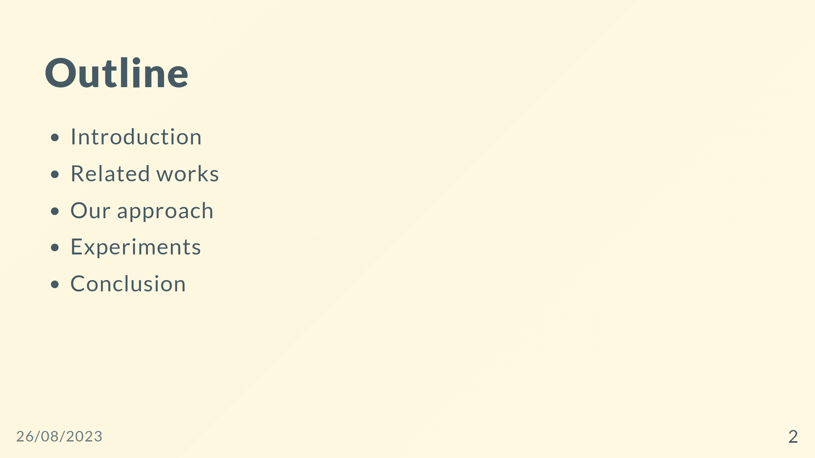

Slide 3
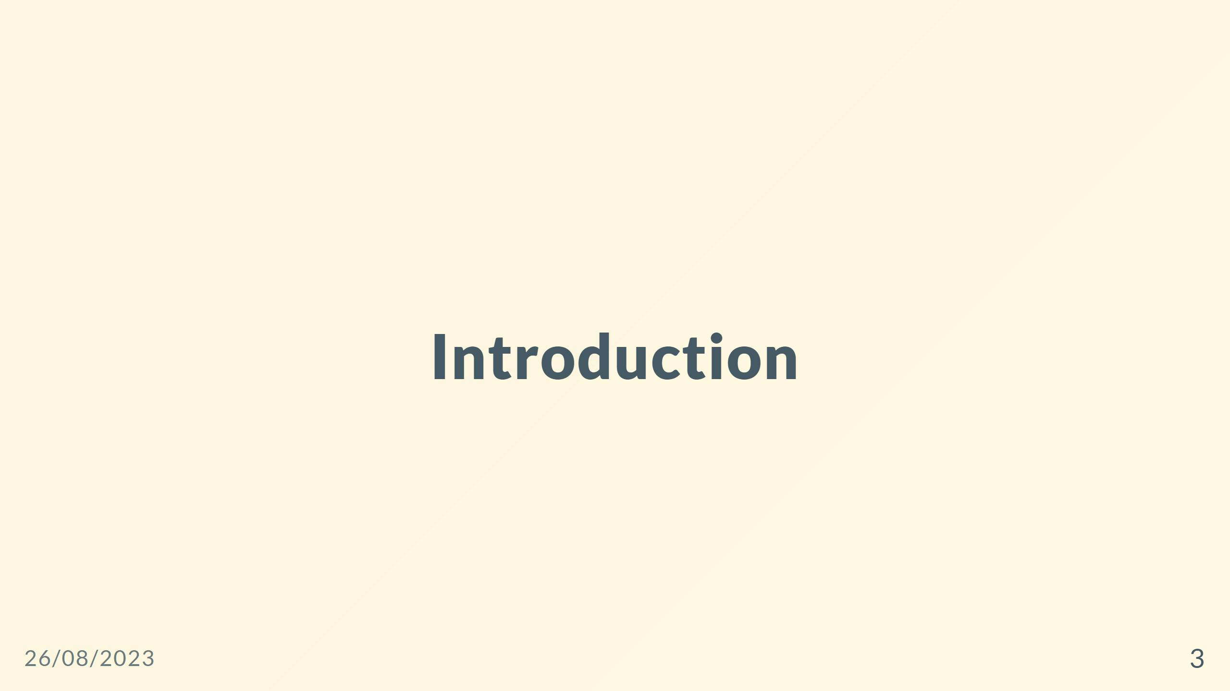

Slide 4
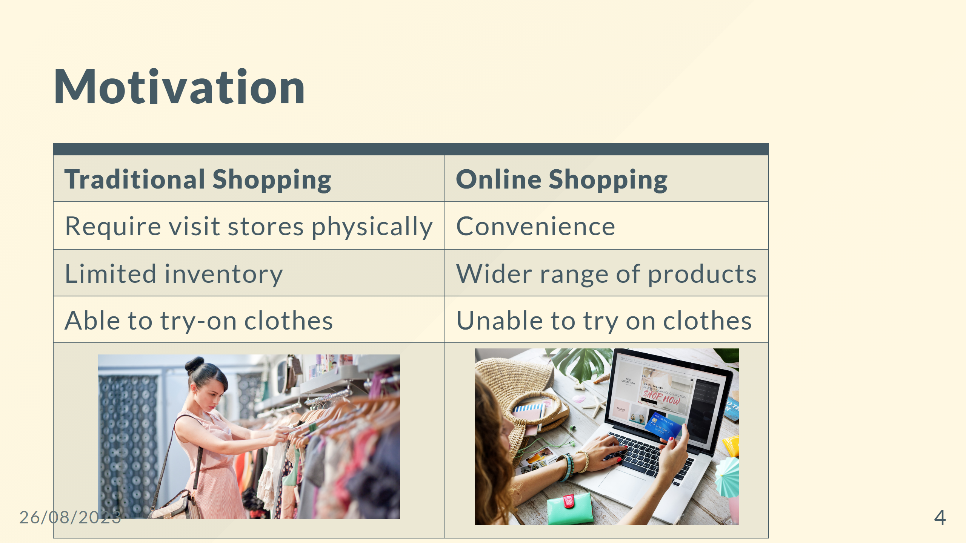

Slide 5
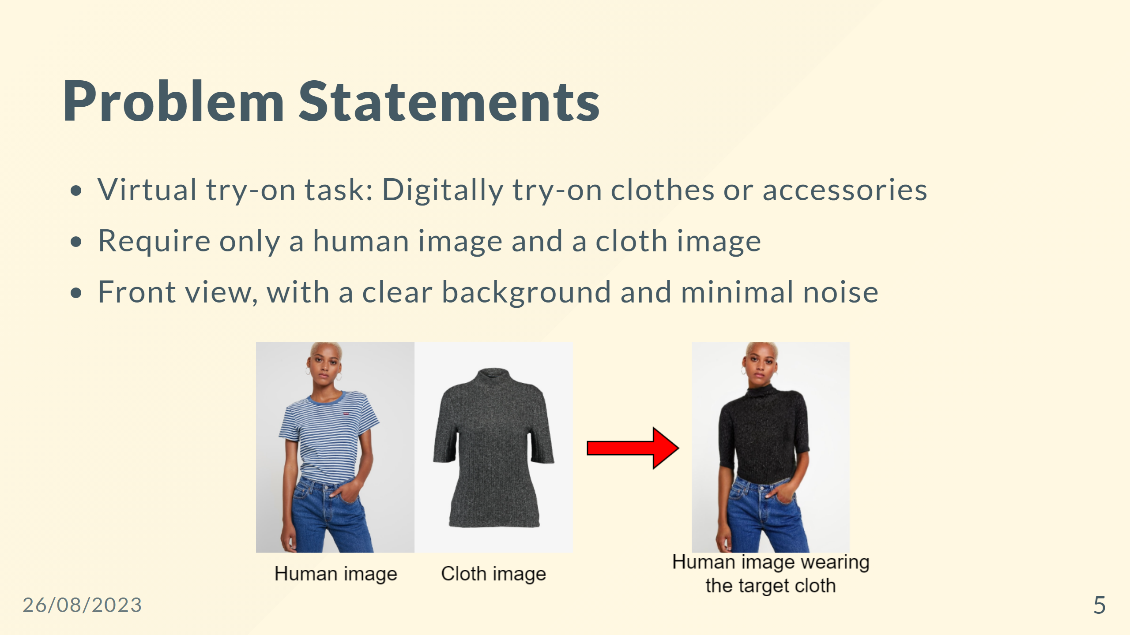

Slide 6


Slide 7
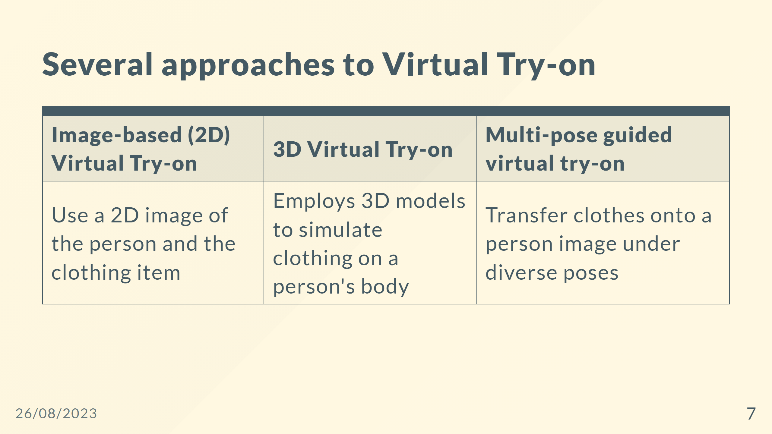
Notes:
|<span style="font-size:30px">Suitable for mobile apps and e-commerce platforms </span> | <span style="font-size:30px">Commonly used in virtual reality (VR) applications and high-end fashion industry </span>|<span style="font-size:30px">Used in various applications for versatile try-on experiences </span>| - Virtual try-on with diffusion models

Slide 8
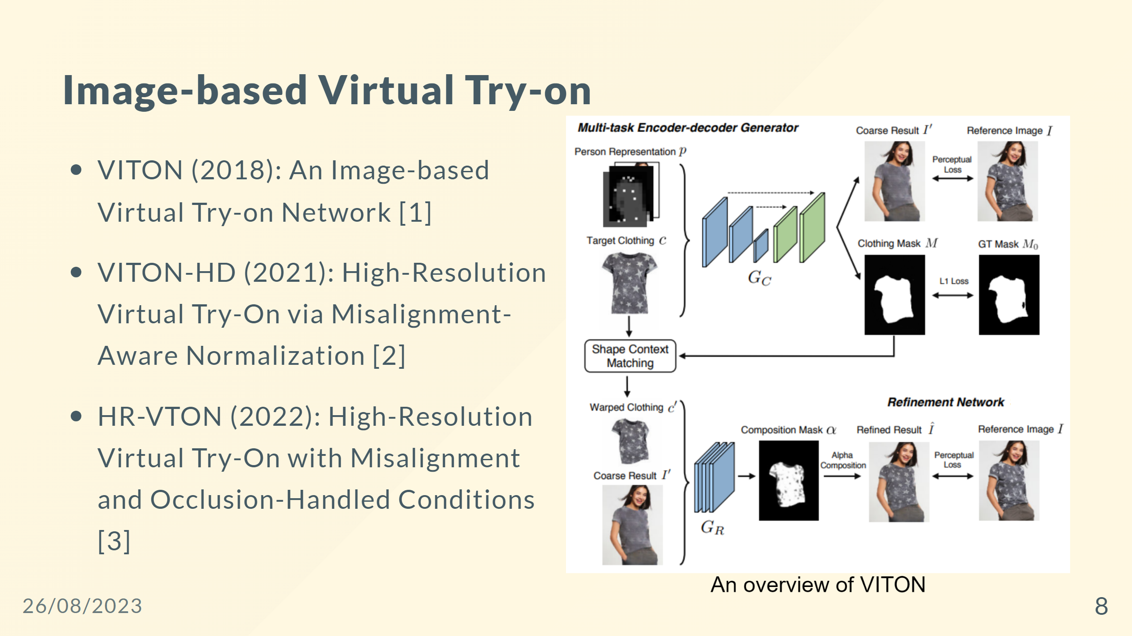

Slide 9
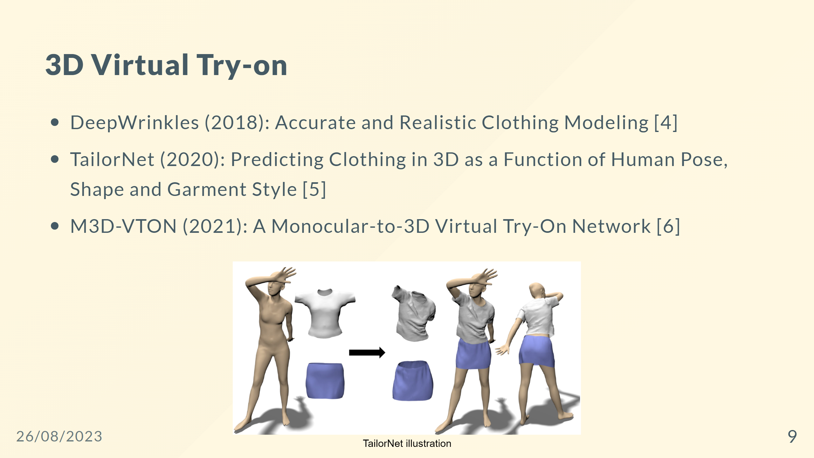

Slide 10
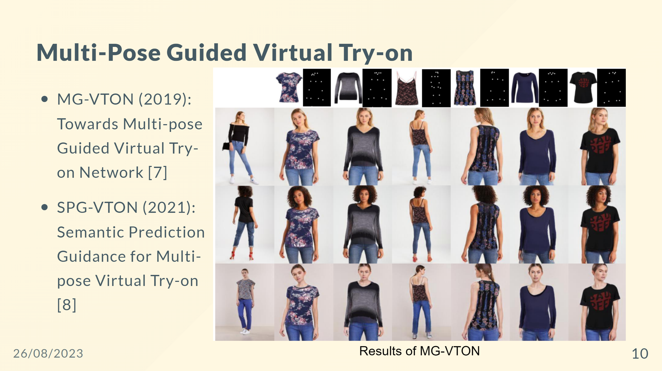

Slide 11
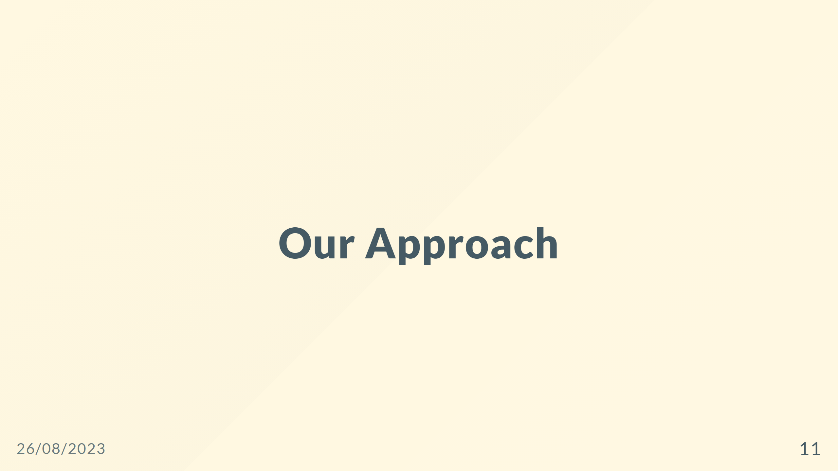

Slide 12
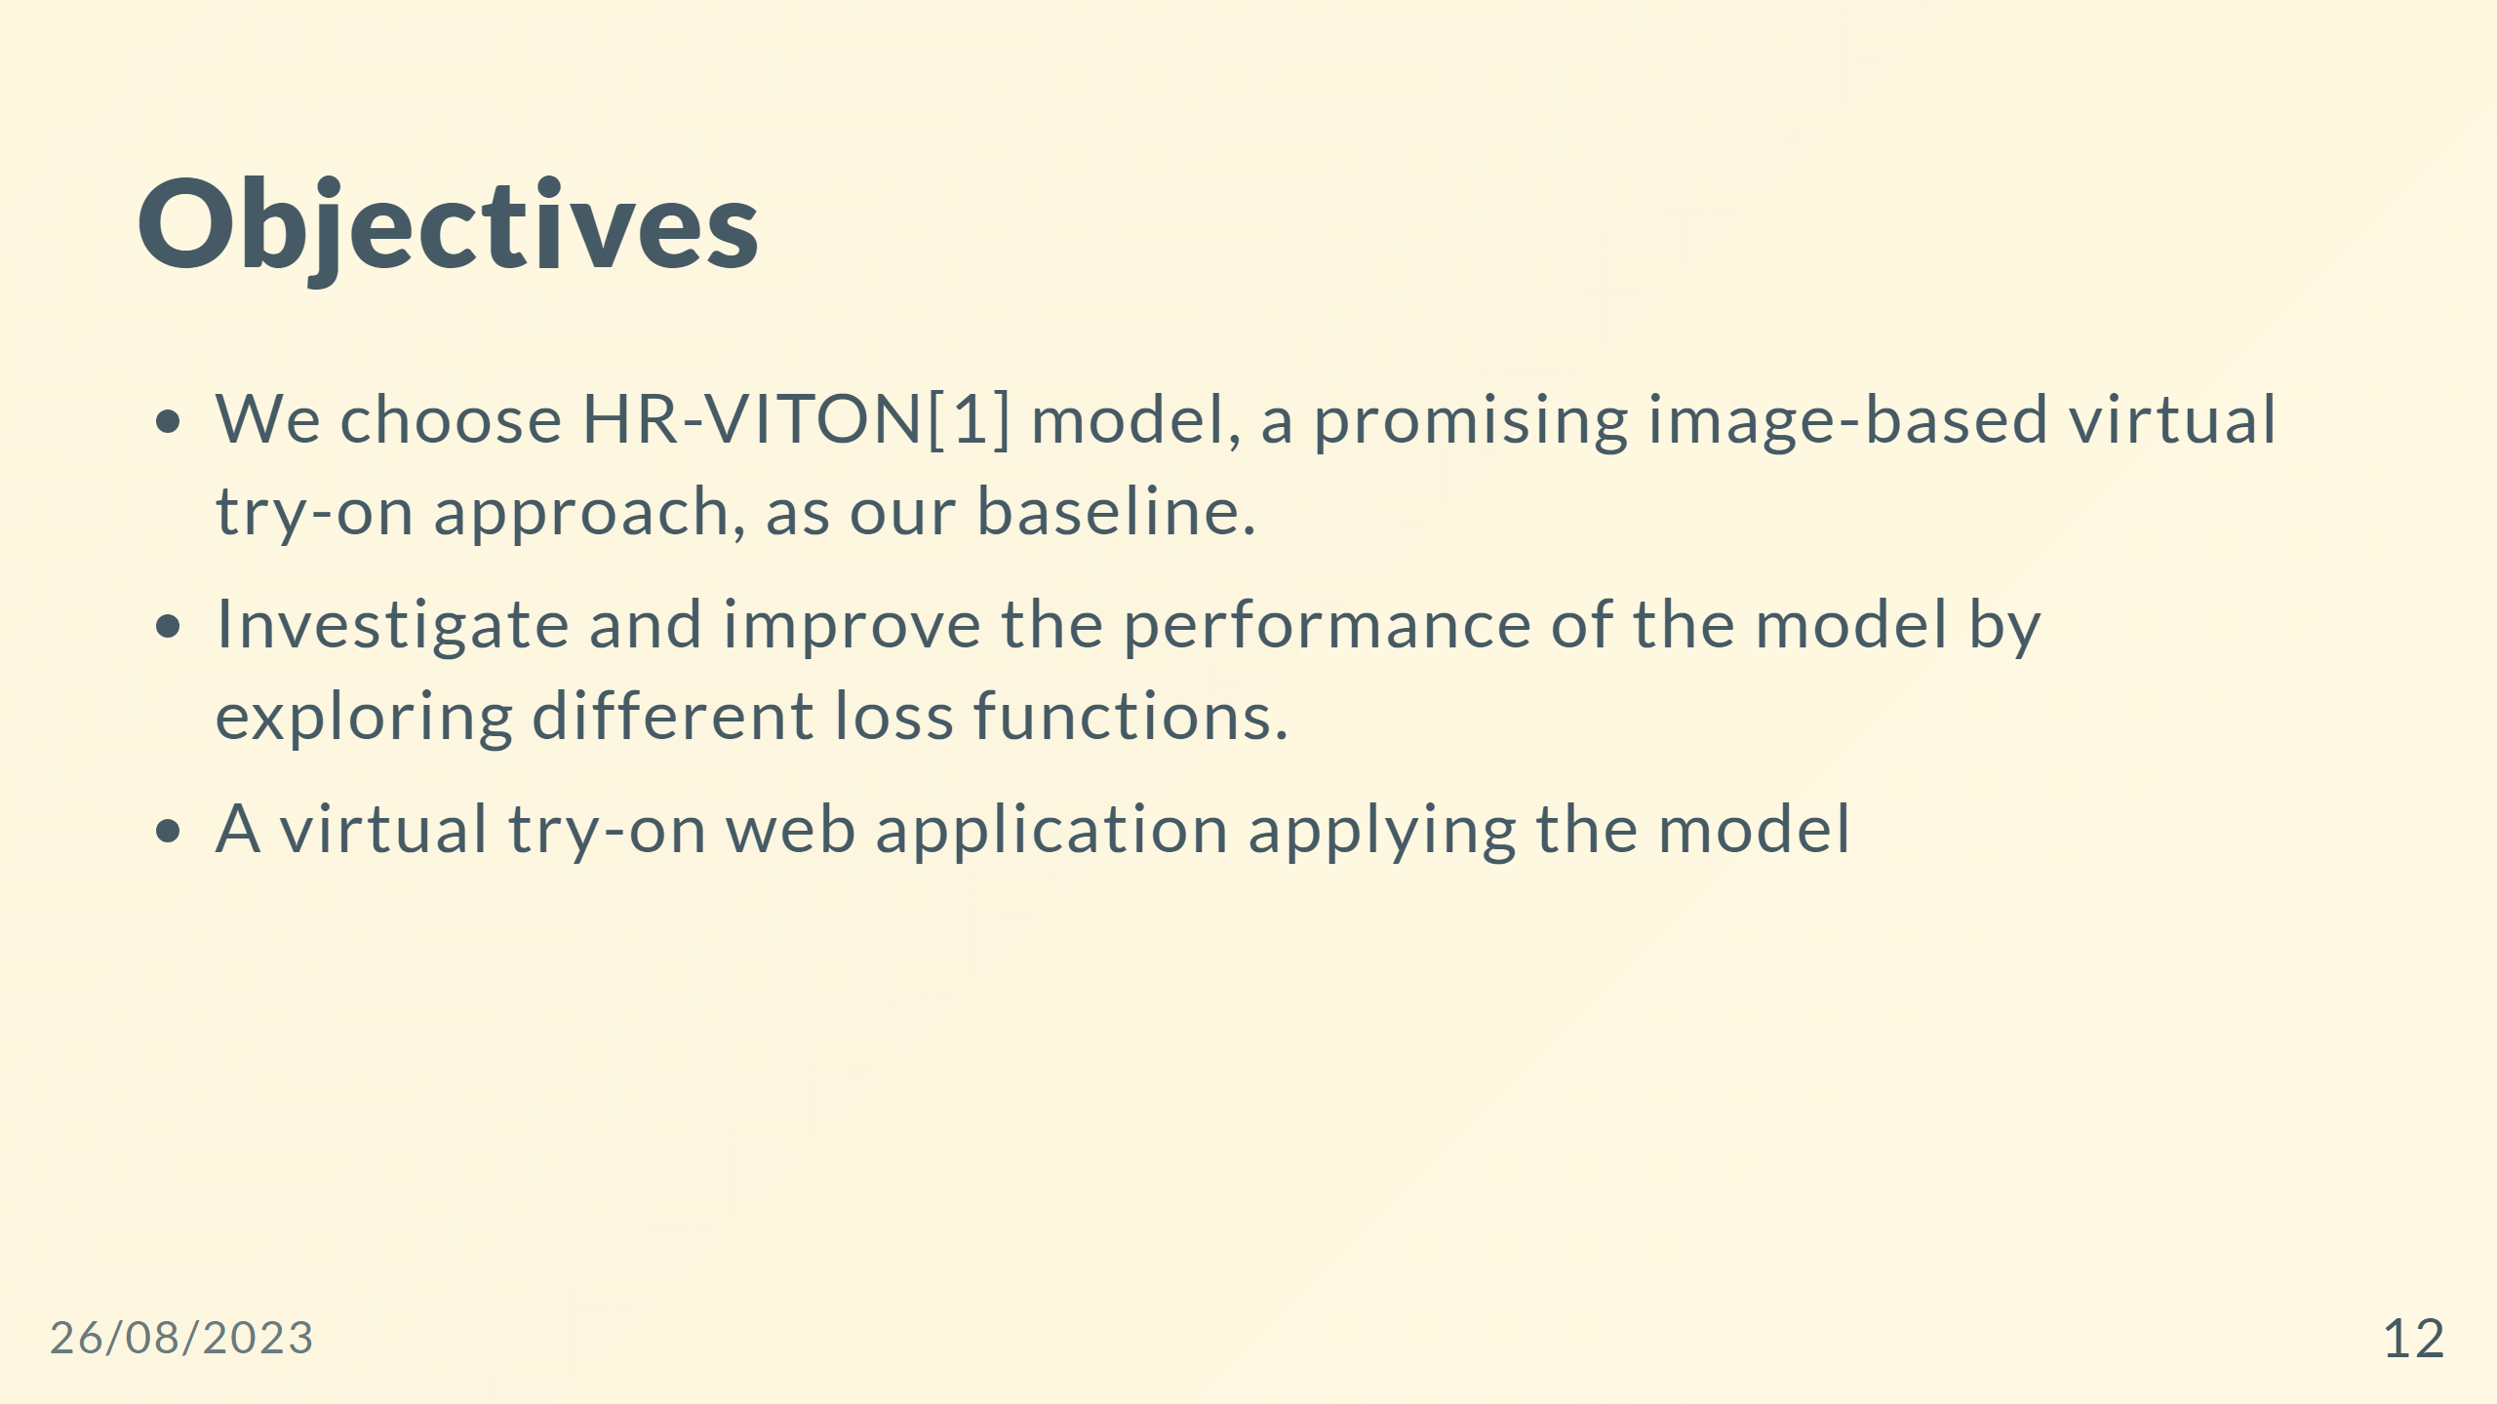

Slide 13
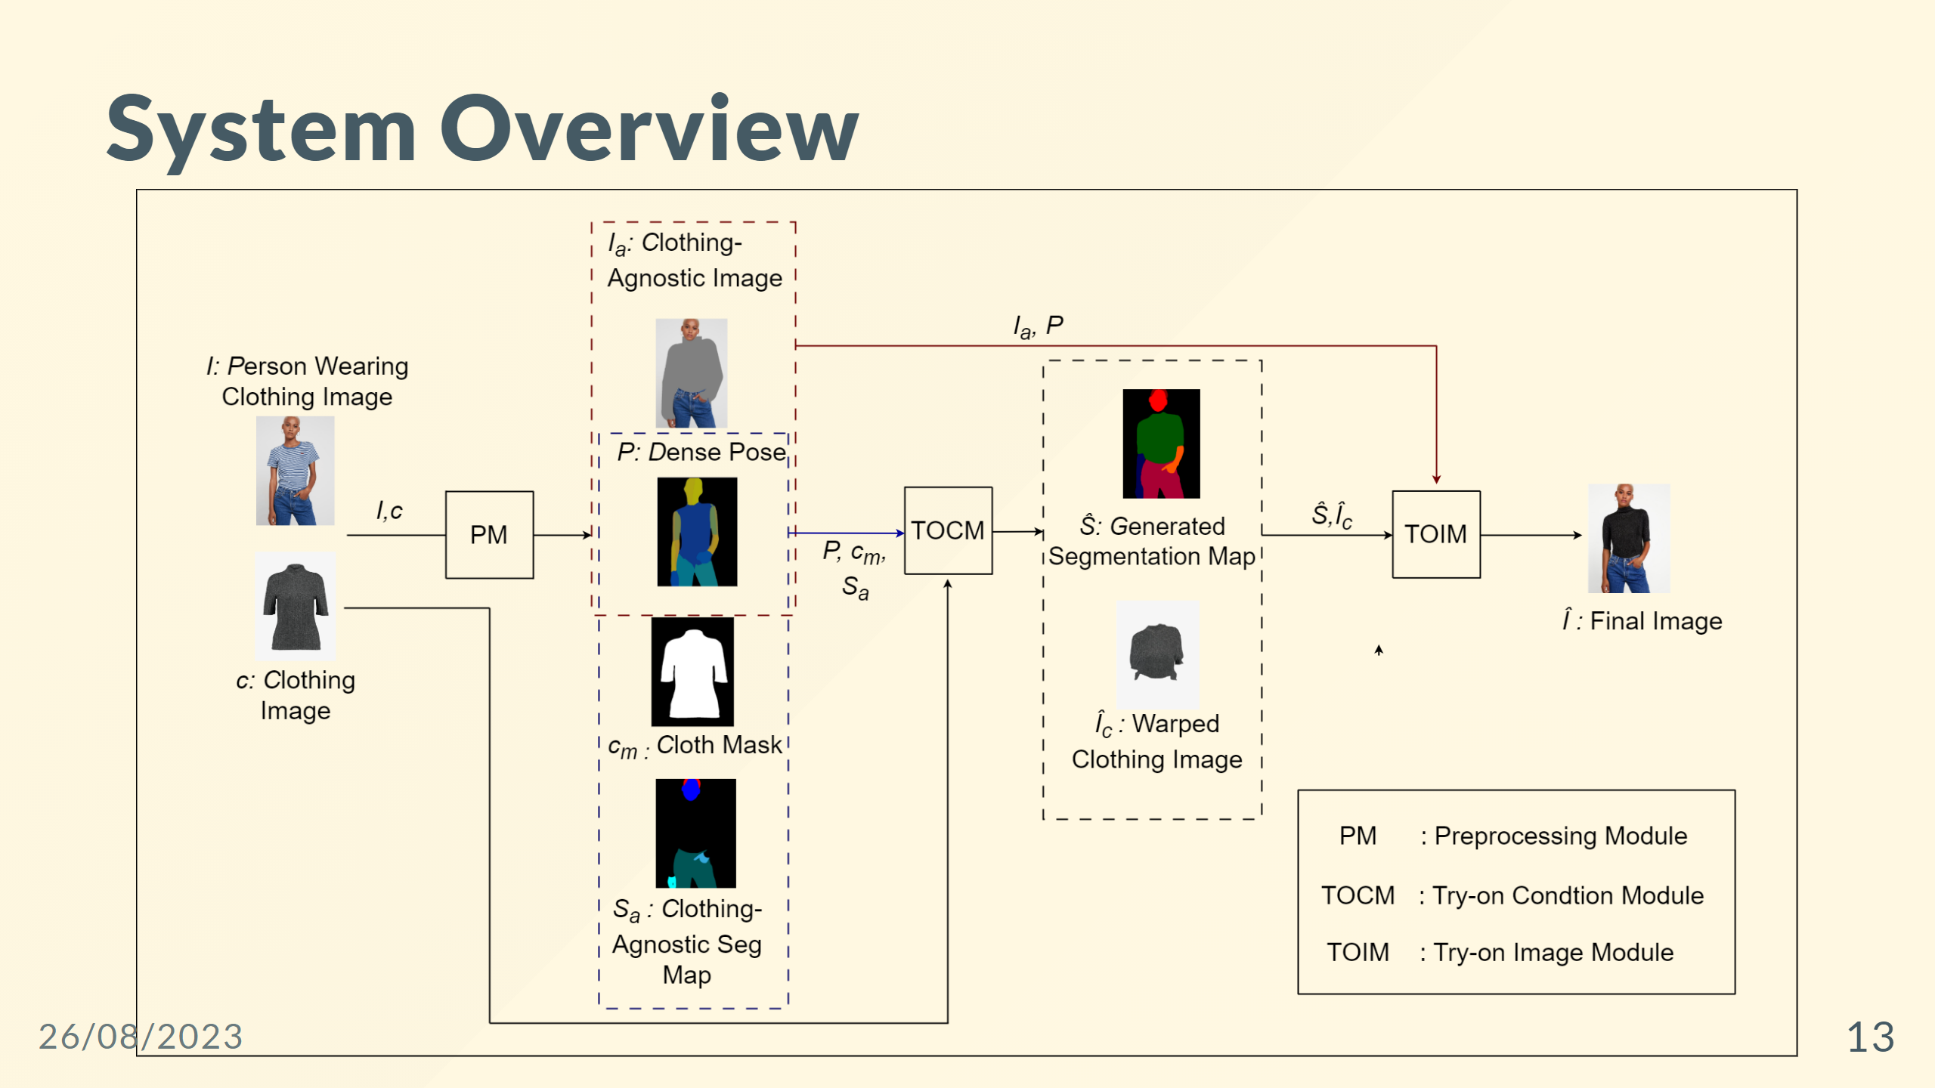

Slide 14
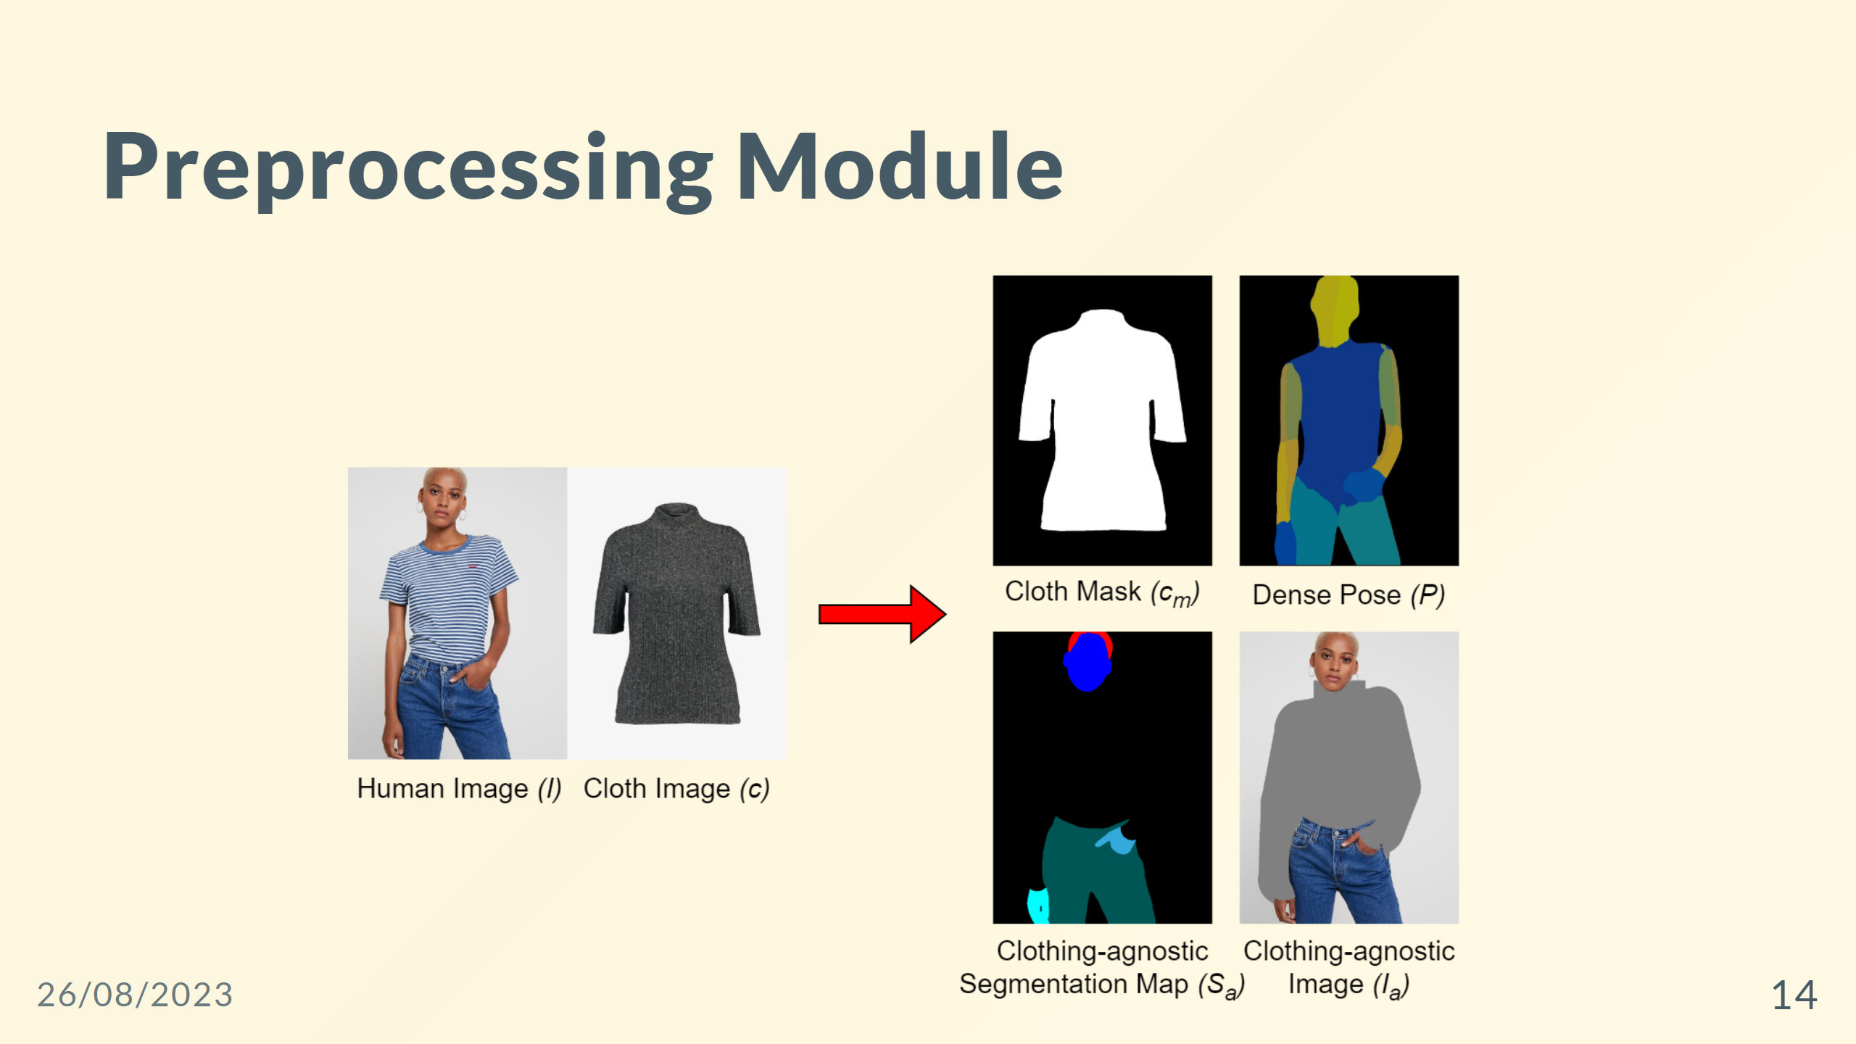
Notes:
--- ![width:850 centernotop](pre-processing_agnostic.png) <div style="color: black; font-size: 30px; margin-top: 30px; text-align: center; "> <b>Clothing-agnostic Processing Flow </b> </div>

Slide 15
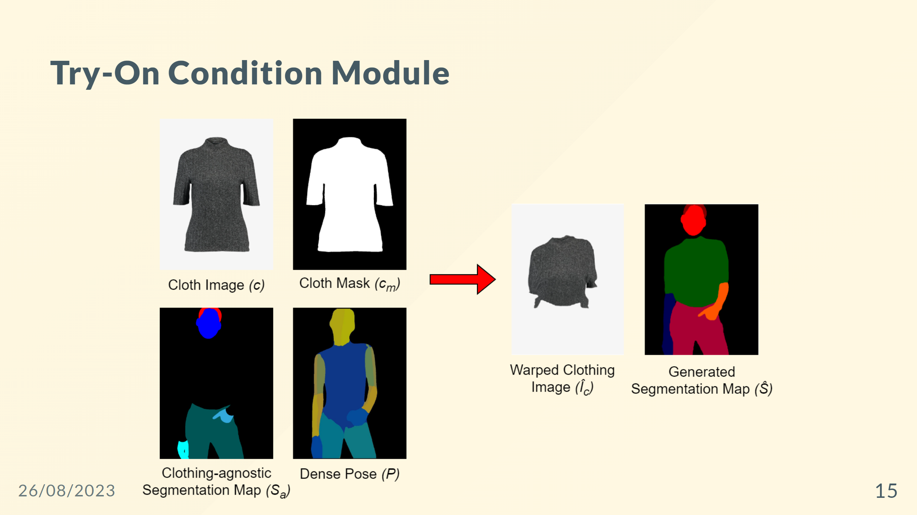

Slide 16
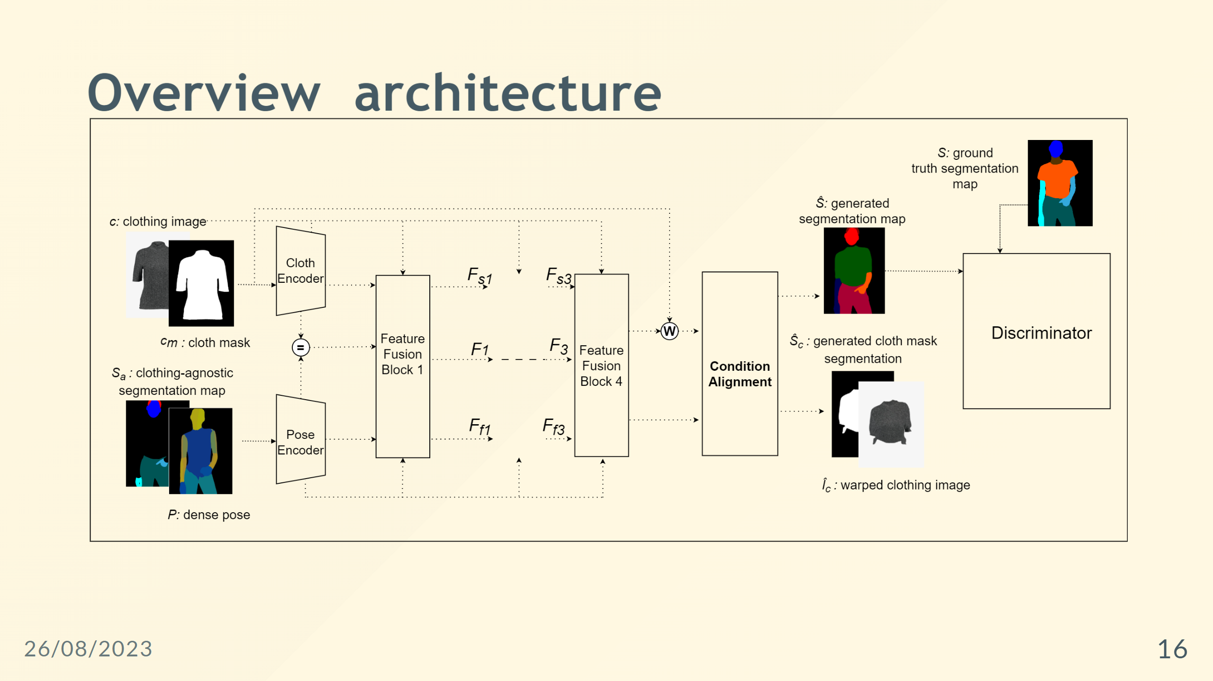

Slide 17
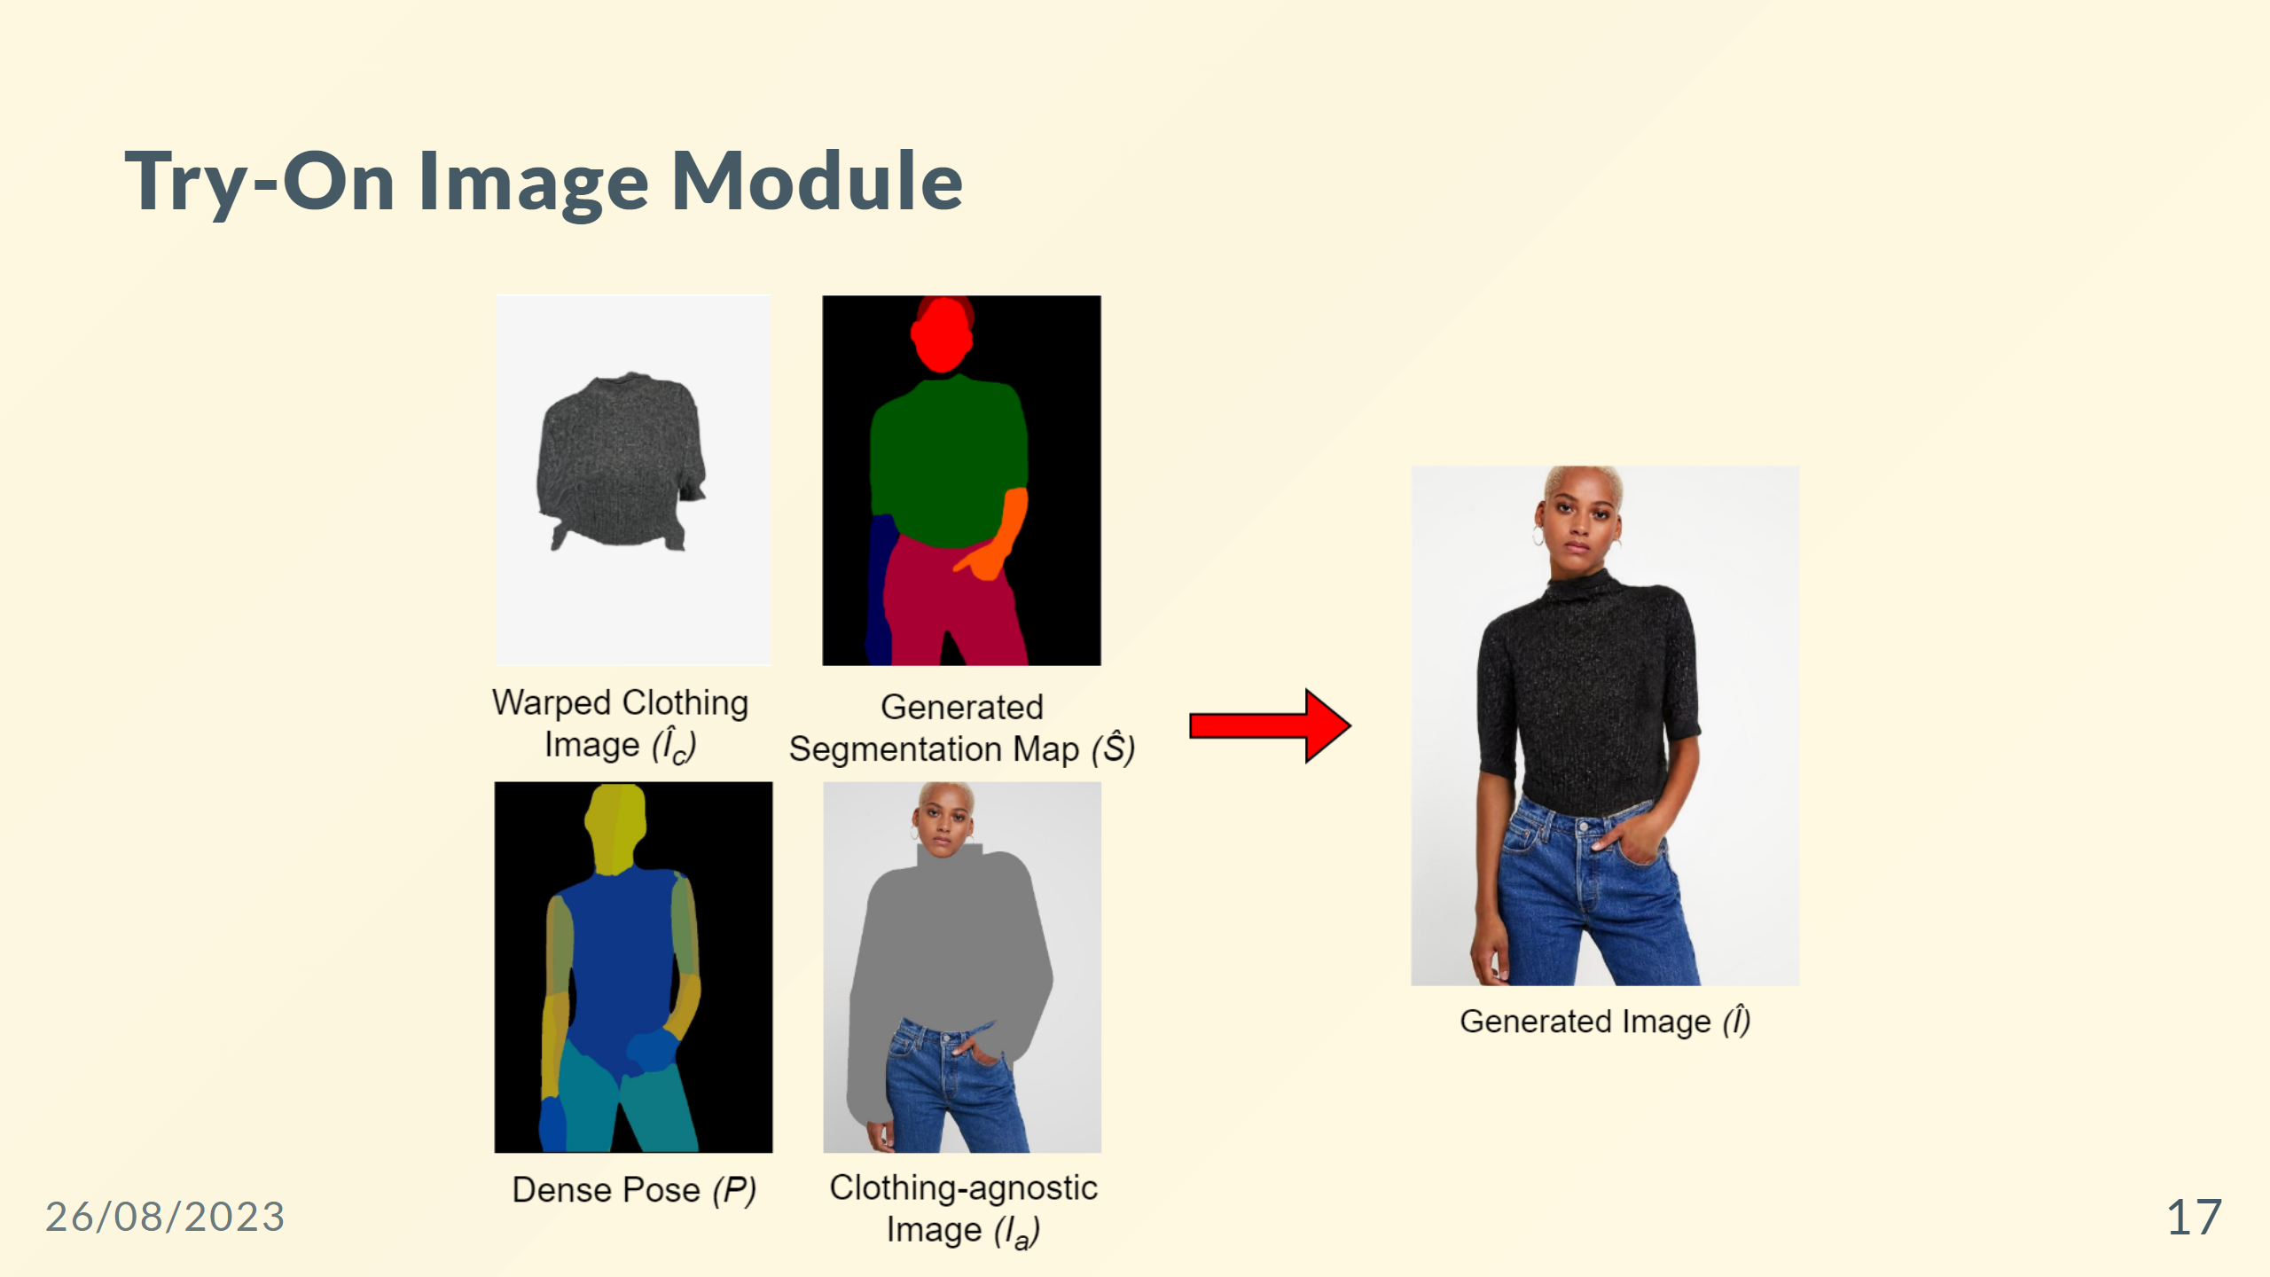

Slide 18
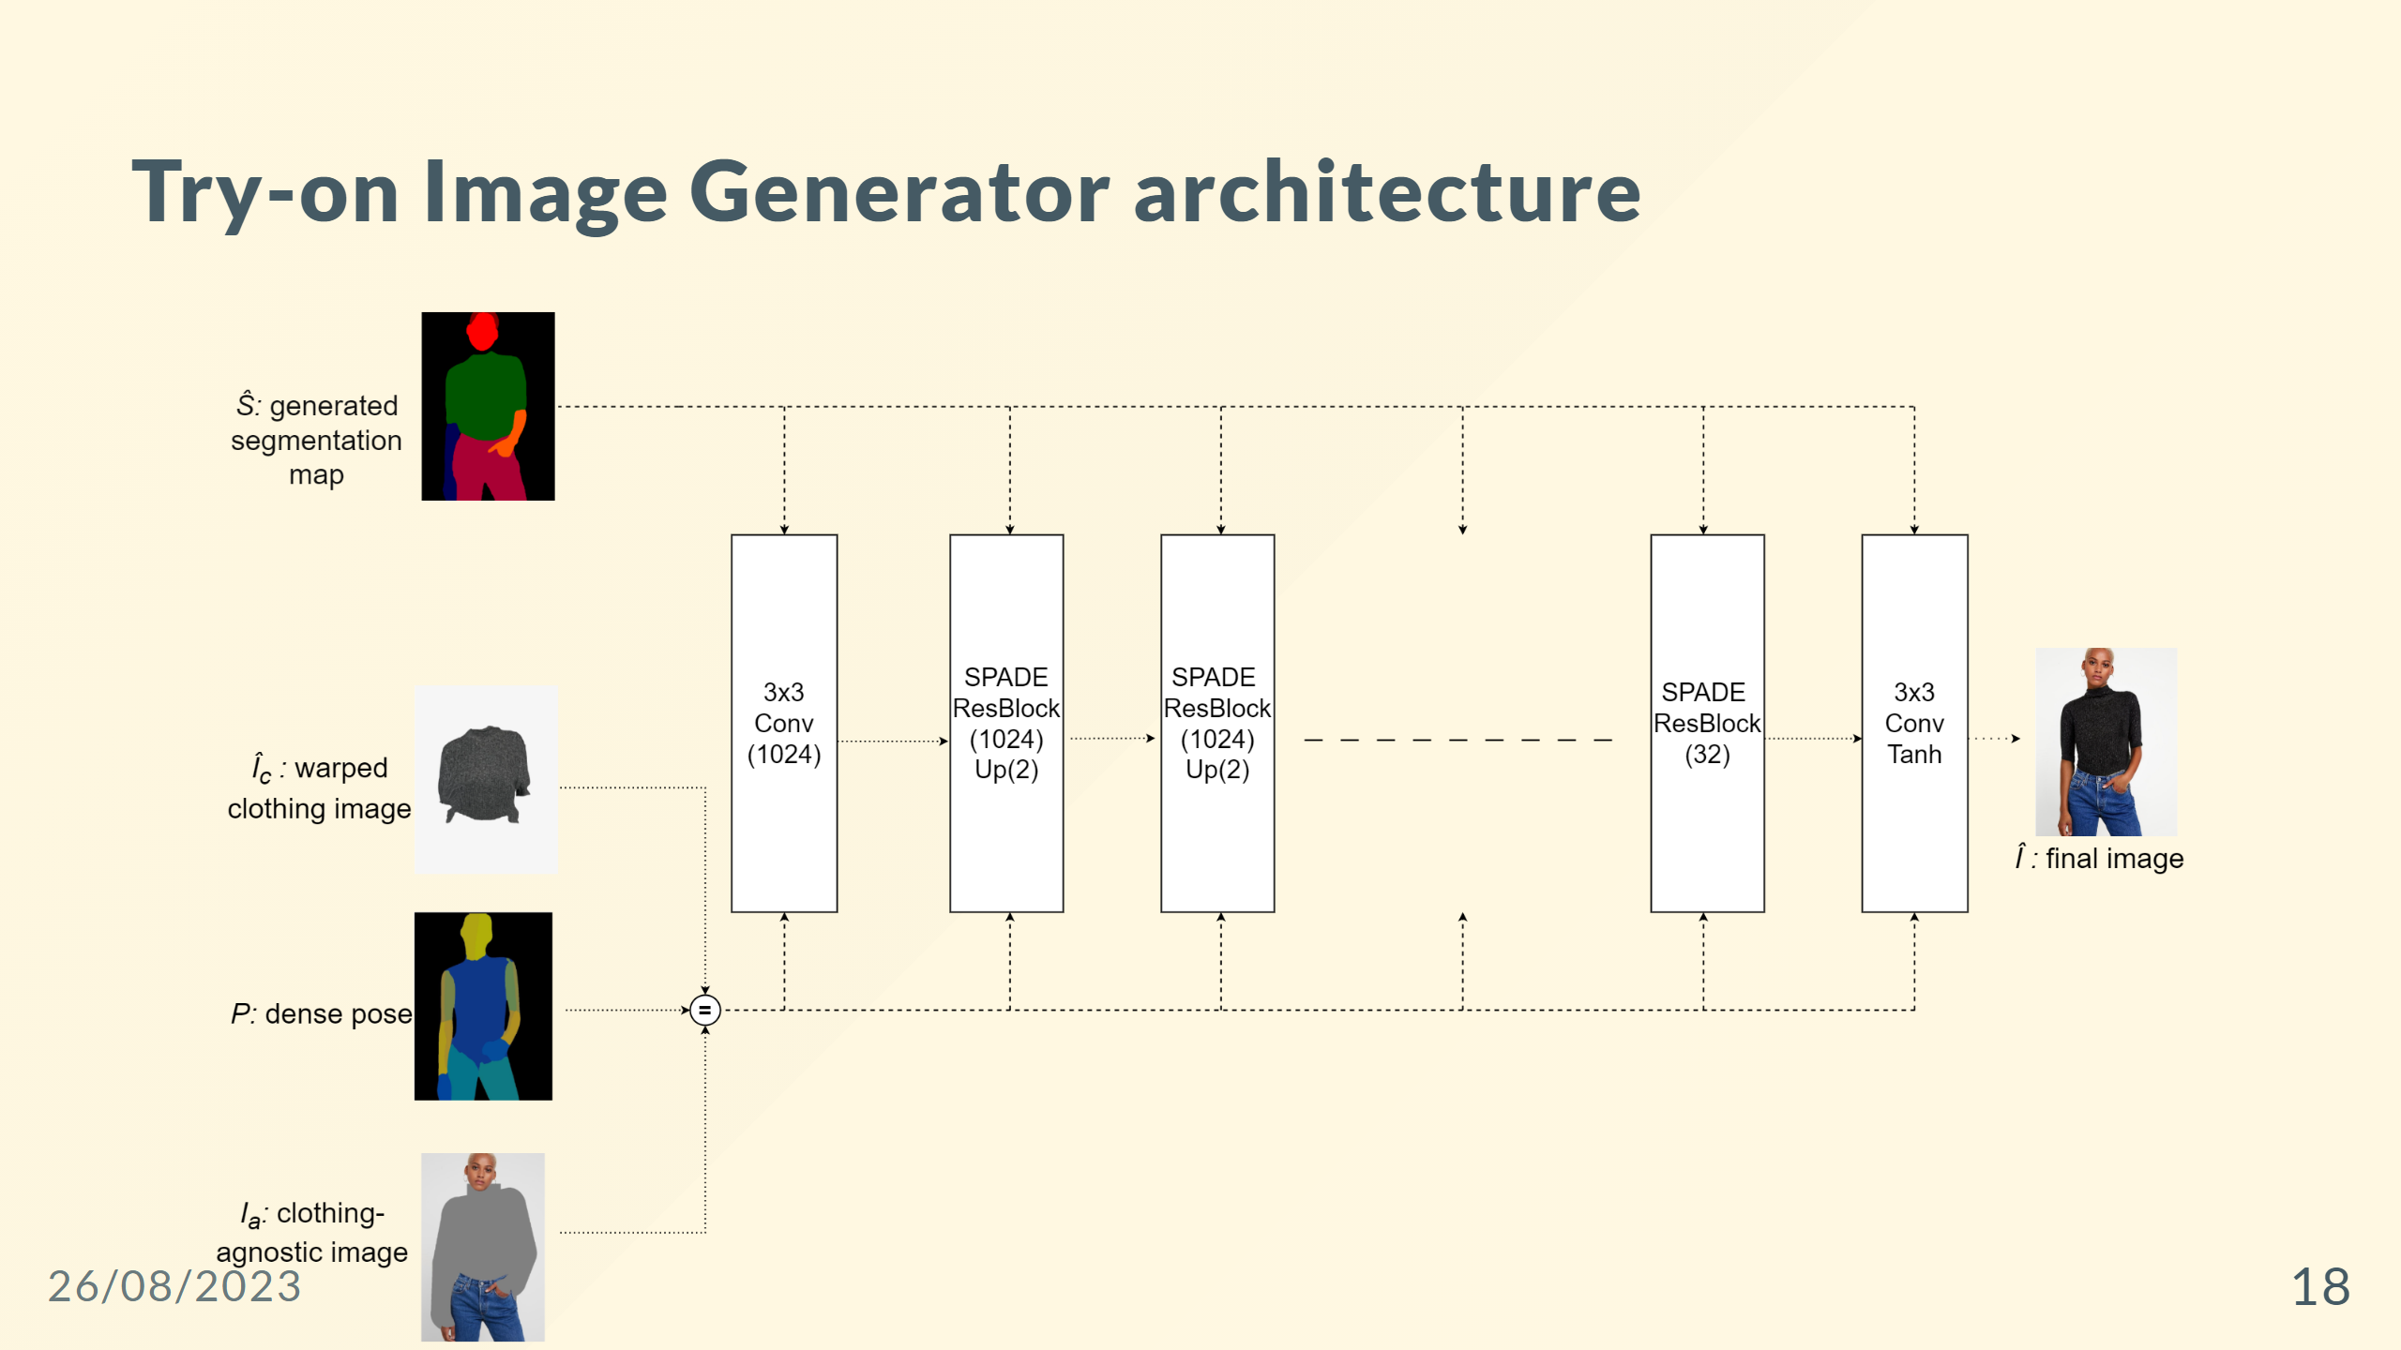
Notes:
--- ### SPADE Residual Block ![width:1200 centernotop](ResBlock.png)

Slide 19
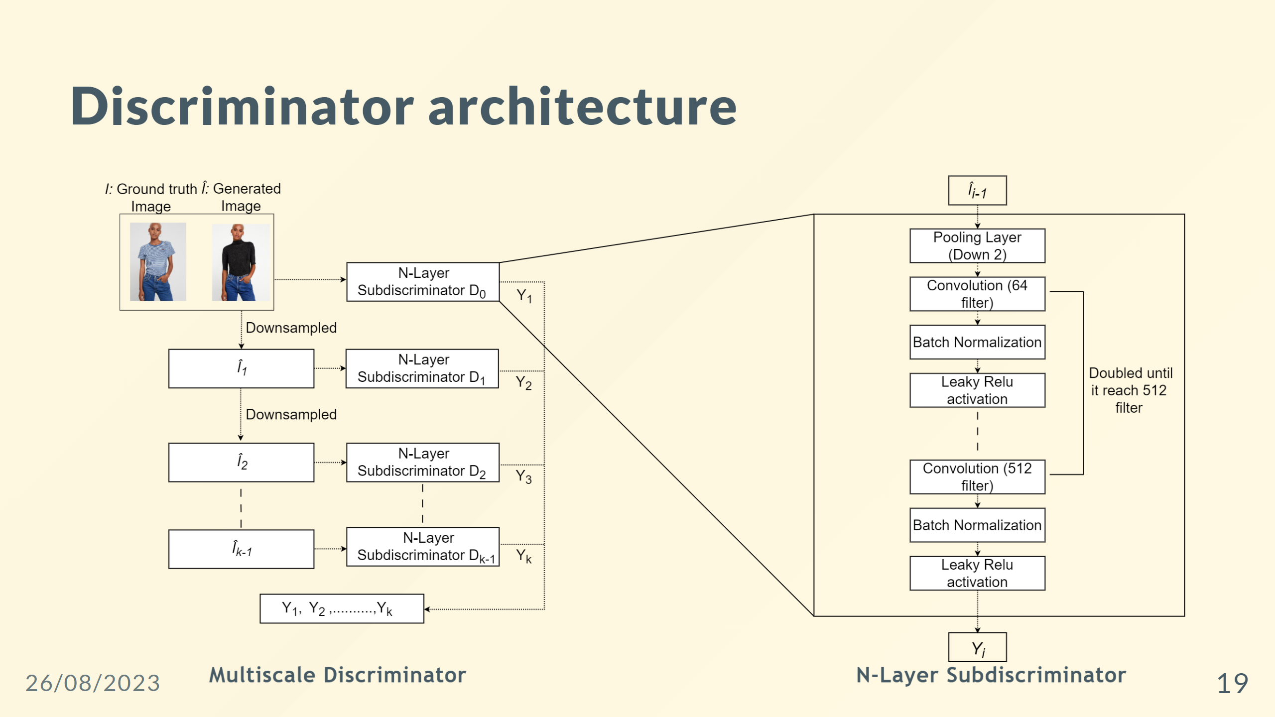

Slide 20
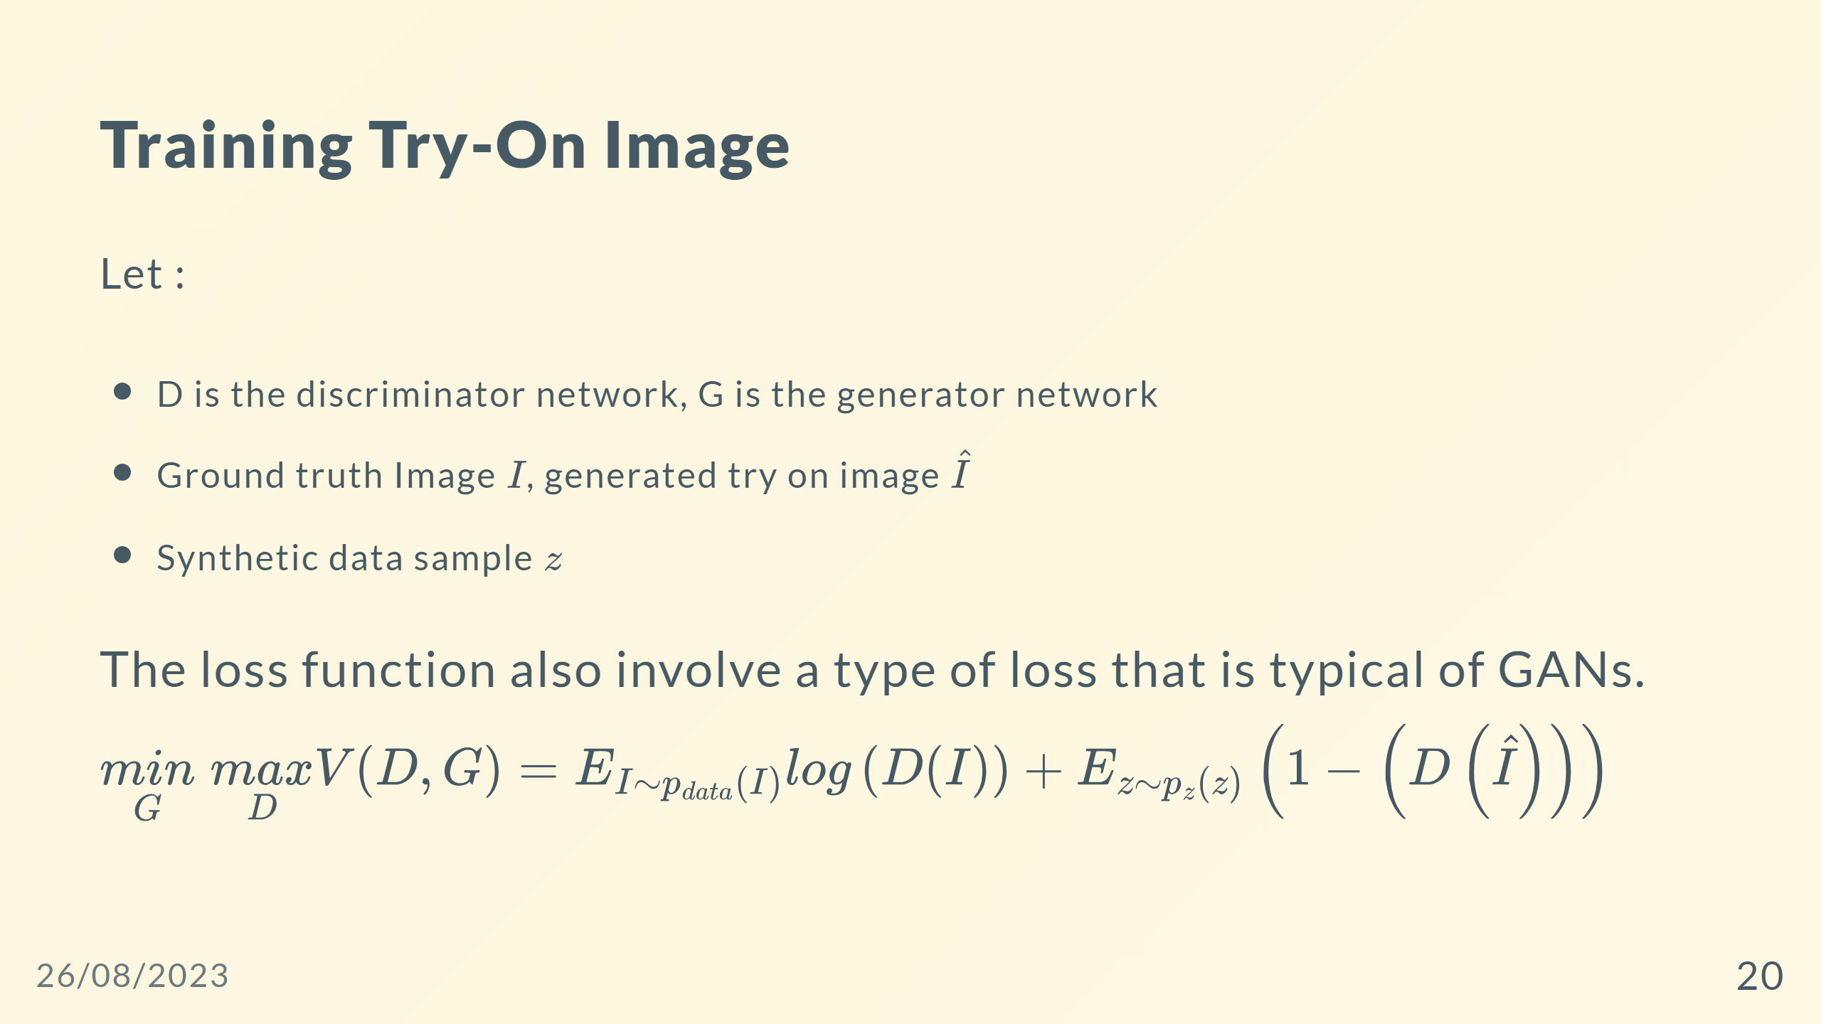

Slide 21
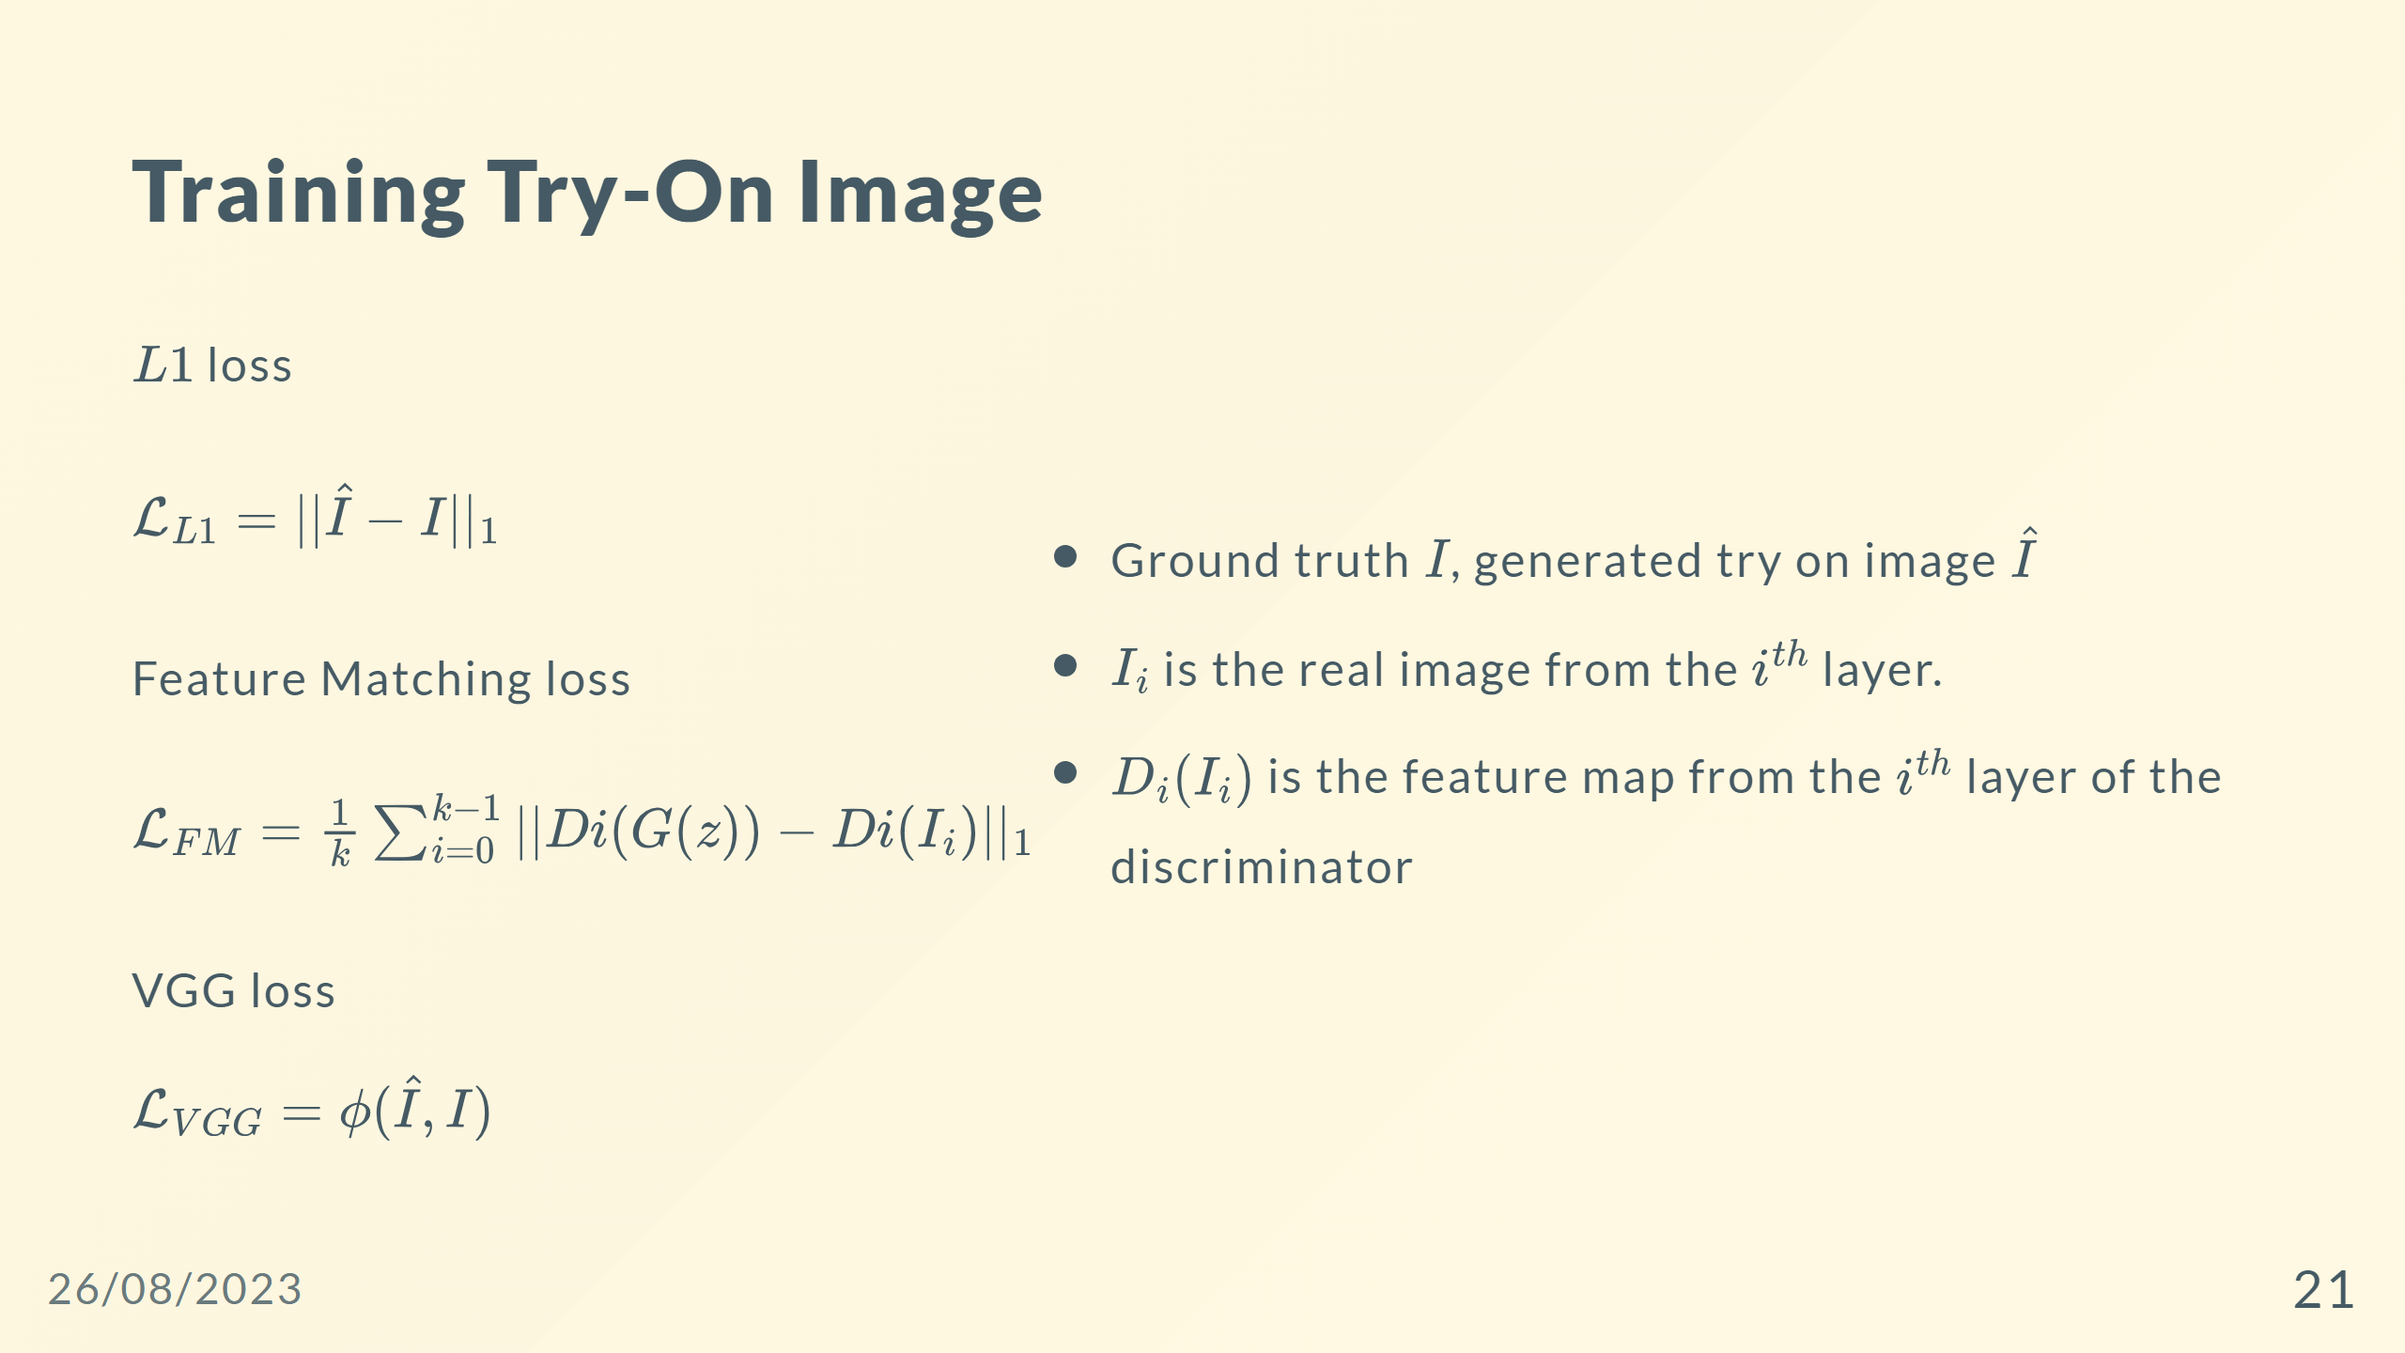

Slide 22
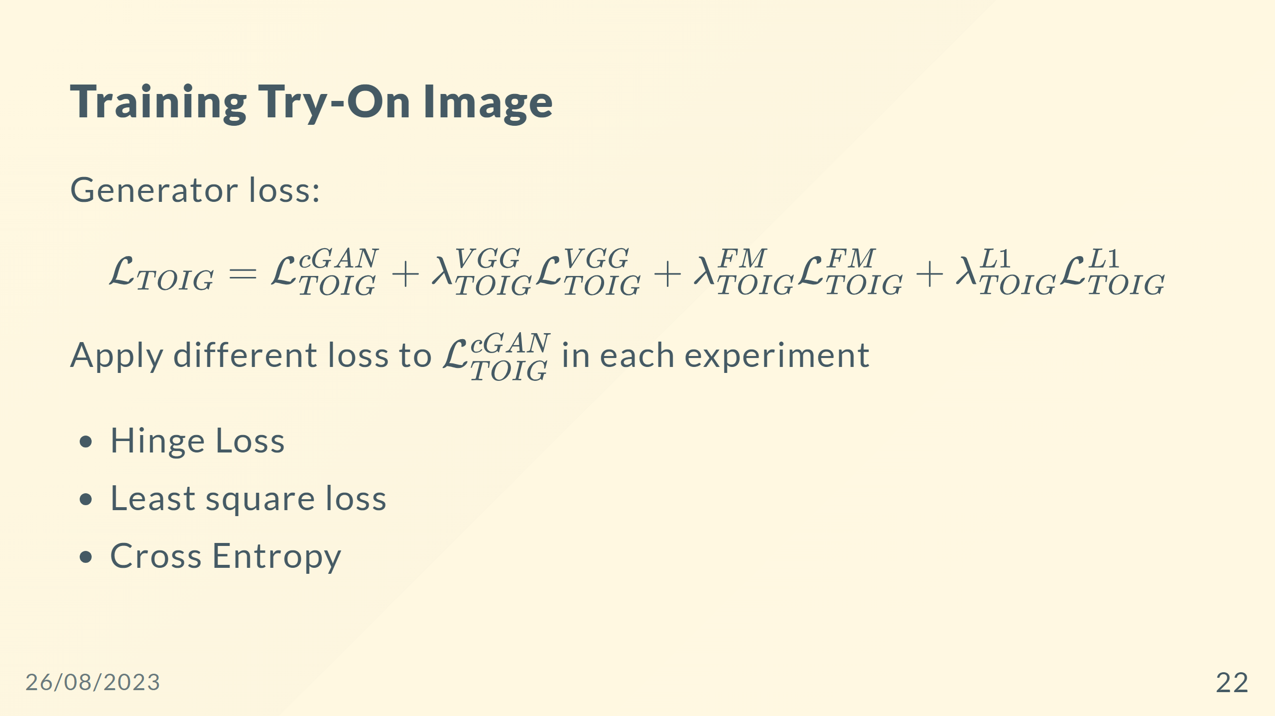

Slide 23
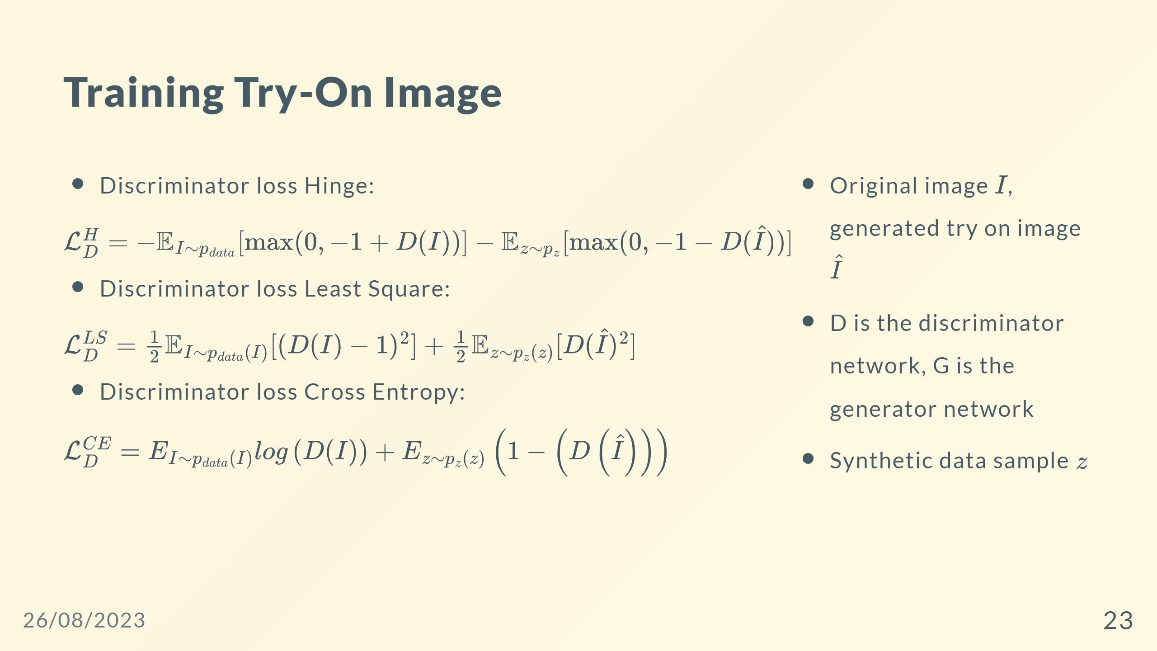

Slide 24
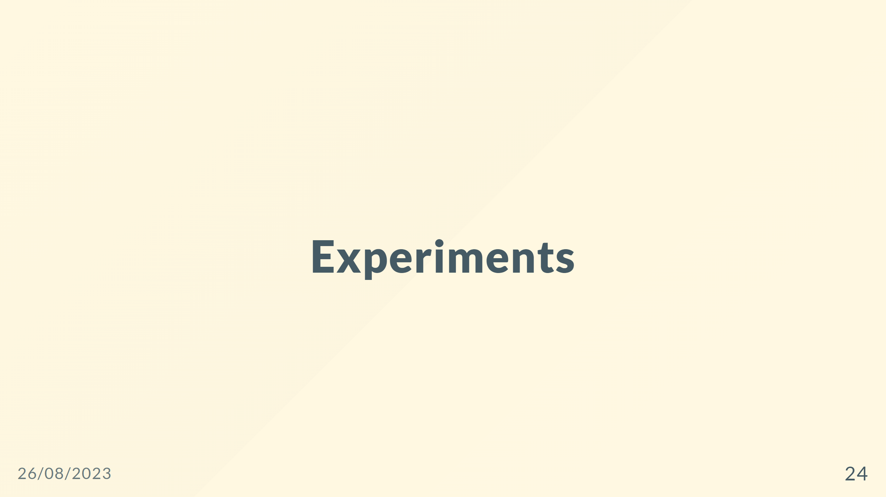

Slide 25
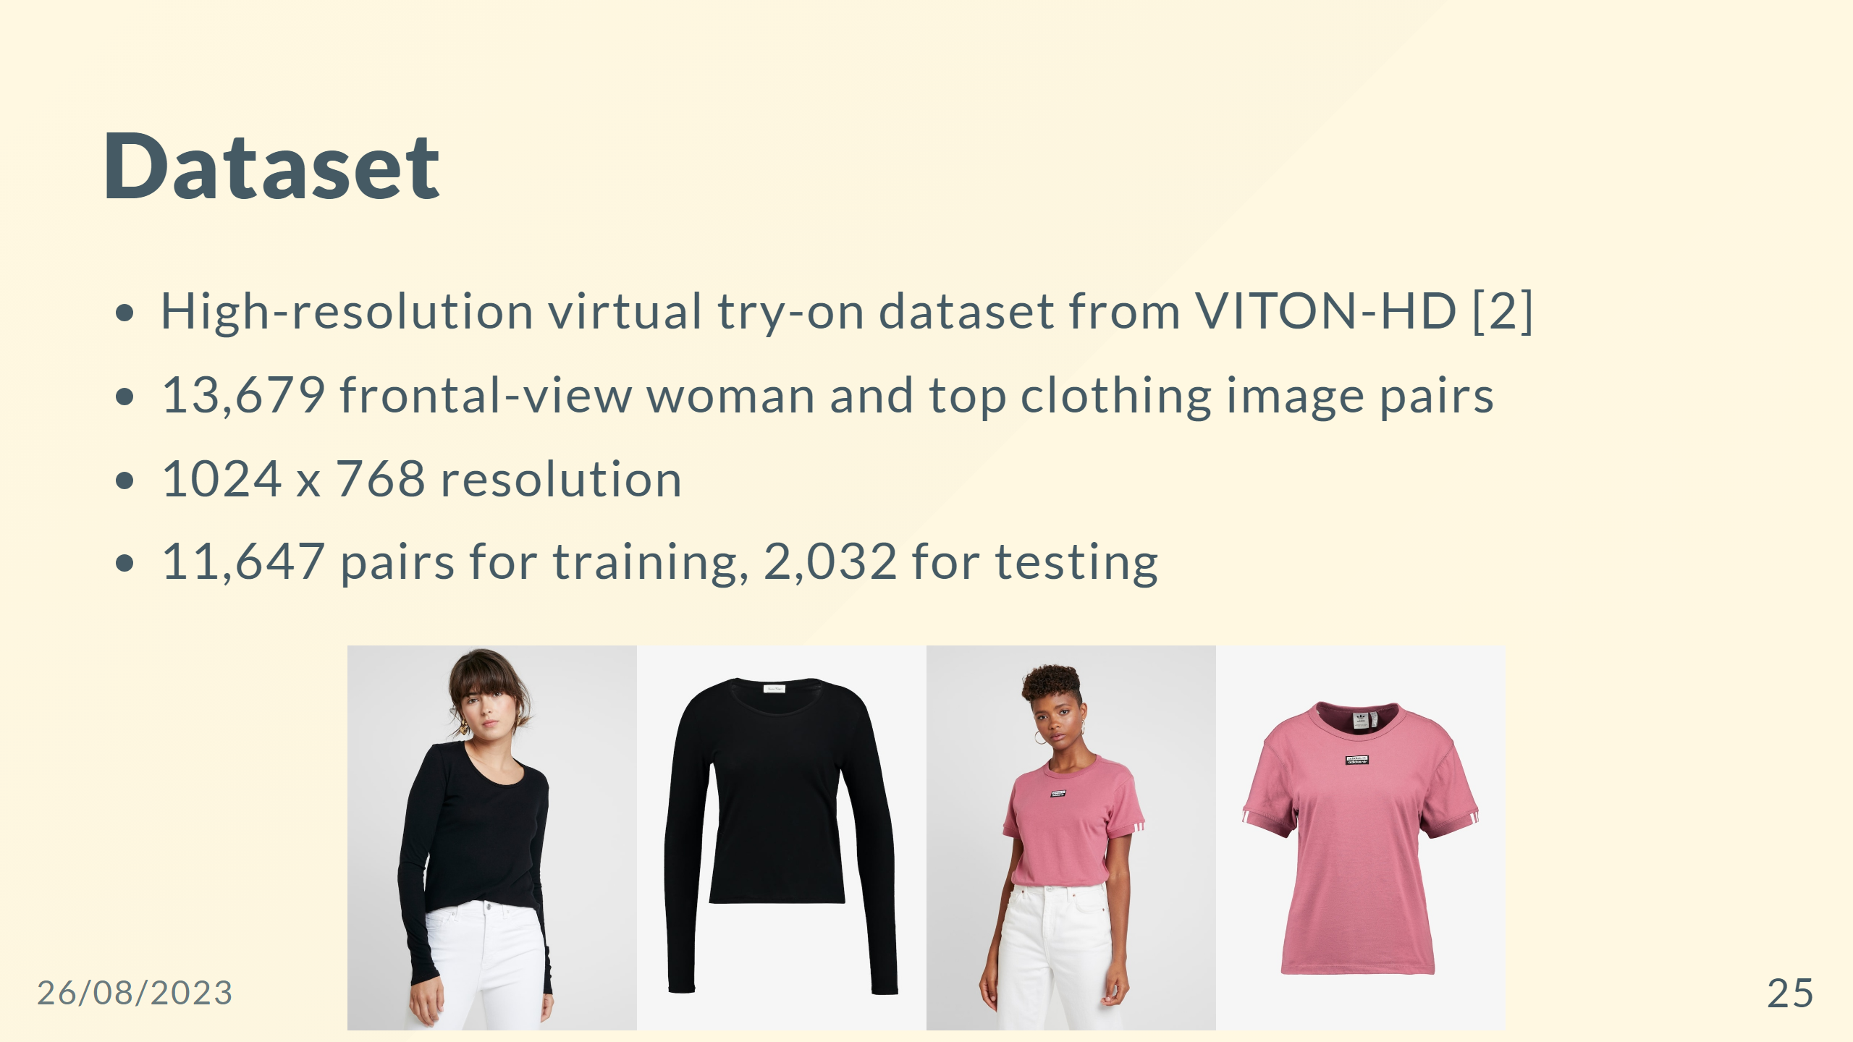

Slide 26
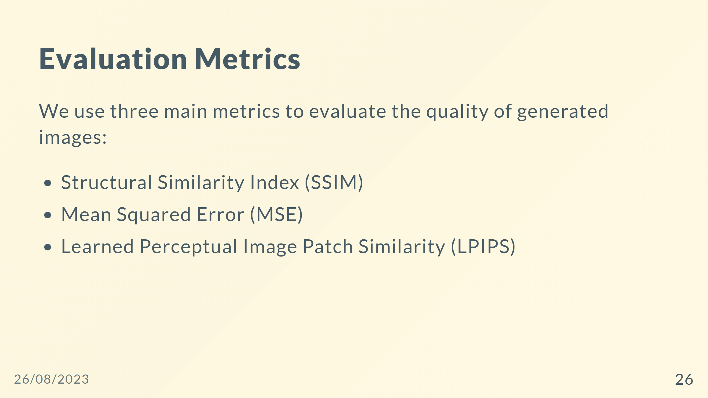
Notes:
## Evaluation Metrics - Structural Similarity Index (SSIM) $SSIM(x, y) = \frac{(2\mu_x\mu_y + C_1)(2\sigma_{xy} + C_2)}{(\mu_x^2 + \mu_y^2 + C_1)(\sigma_x^2 + \sigma_y^2 + C_2)}$ - Mean Squared Error (MSE) $MSE(x, y) = \frac{1}{n}\sum_{i=1}^{n}(x_i - y_i)^2$ - Learned Perceptual Image Patch Similarity (LPIPS) $LPIPS(x, y) = \frac{1}{N}\sum_{i=1}^{N}|f_i(x) - f_i(y)|_2$ --- ## Evaluation Metrics <div style="display:flex;flex-direction:row;"> <div style="display:flex;gap:0px;flex-direction:column;align-items:left"> <span style="font-size:30px;"> - Structural Similarity Index (SSIM) $SSIM(x, y) = \frac{(2\mu_x\mu_y + C_1)(2\sigma_{xy} + C_2)}{(\mu_x^2 + \mu_y^2 + C_1)(\sigma_x^2 + \sigma_y^2 + C_2)}$ - Mean Squared Error (MSE) $MSE(x, y) = \frac{1}{n}\sum_{i=1}^{n}(x_i - y_i)^2$ - Learned Perceptual Image Patch Similarity (LPIPS) $LPIPS(x, y) = \frac{1}{N}\sum_{i=1}^{N}|f_i(x) - f_i(y)|_2$ </span> </div> <div style="display:flex;flex-direction:column;justify-content:center;align-items:right"> <span style="font-size:30px;"> With $x$ and $y$ are the two images being compared </span> </div> </div> ---

Slide 27
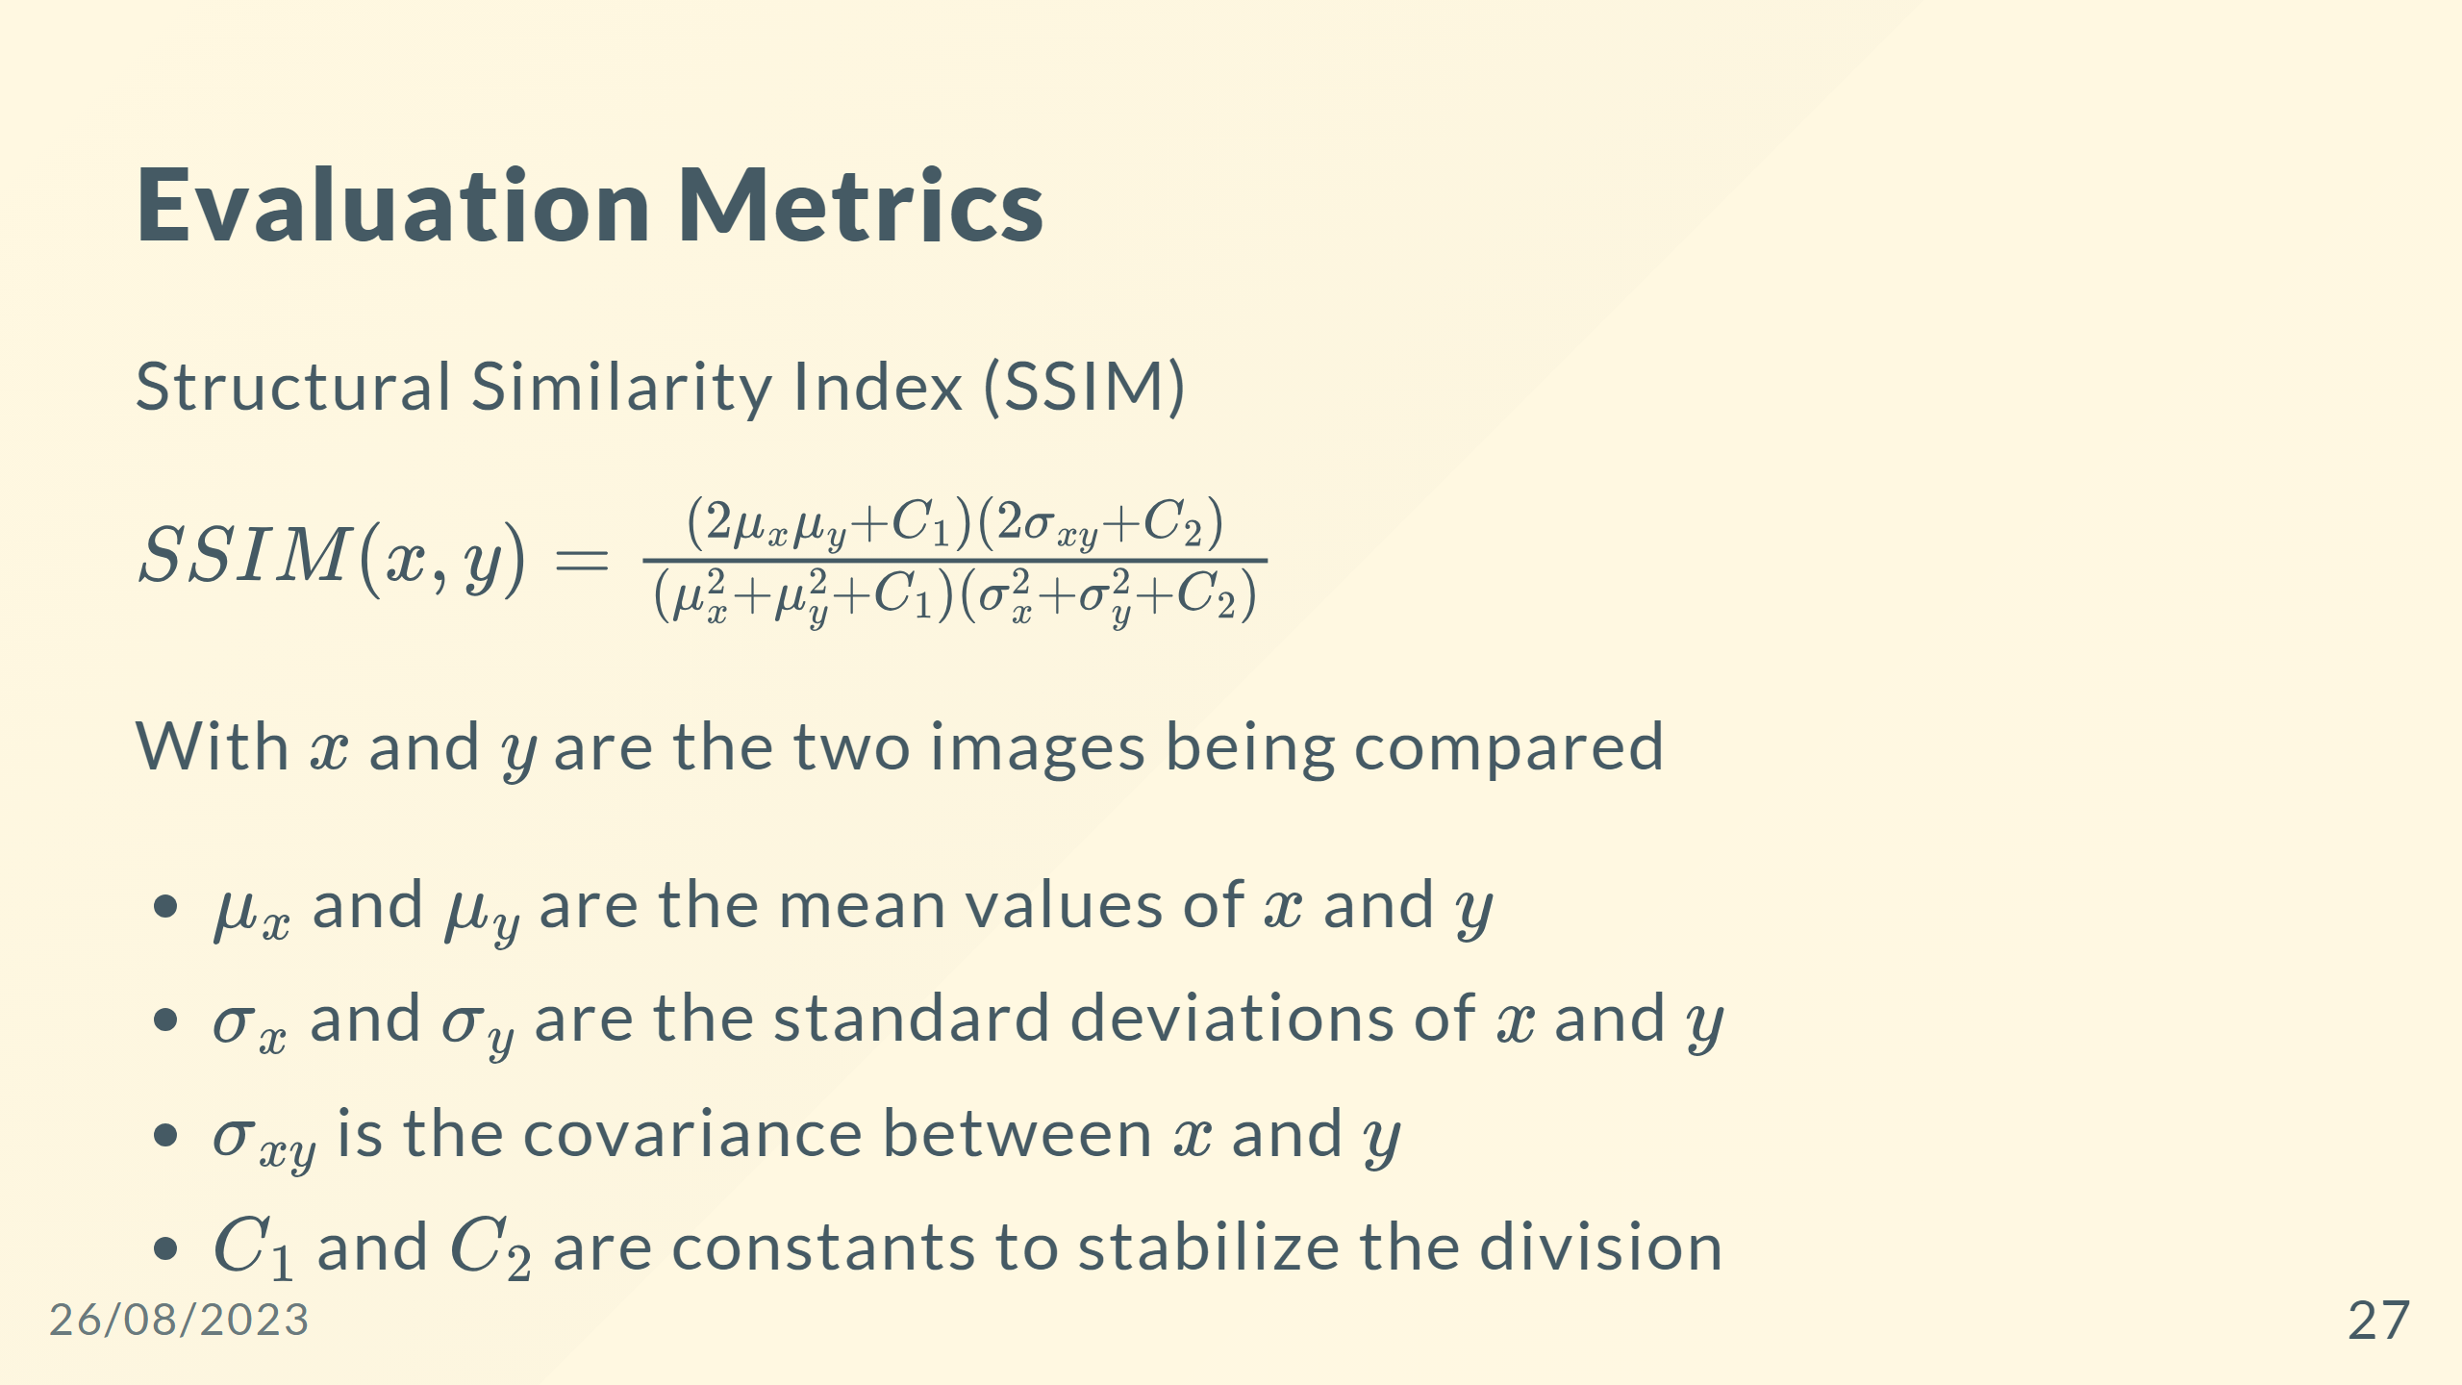

Slide 28
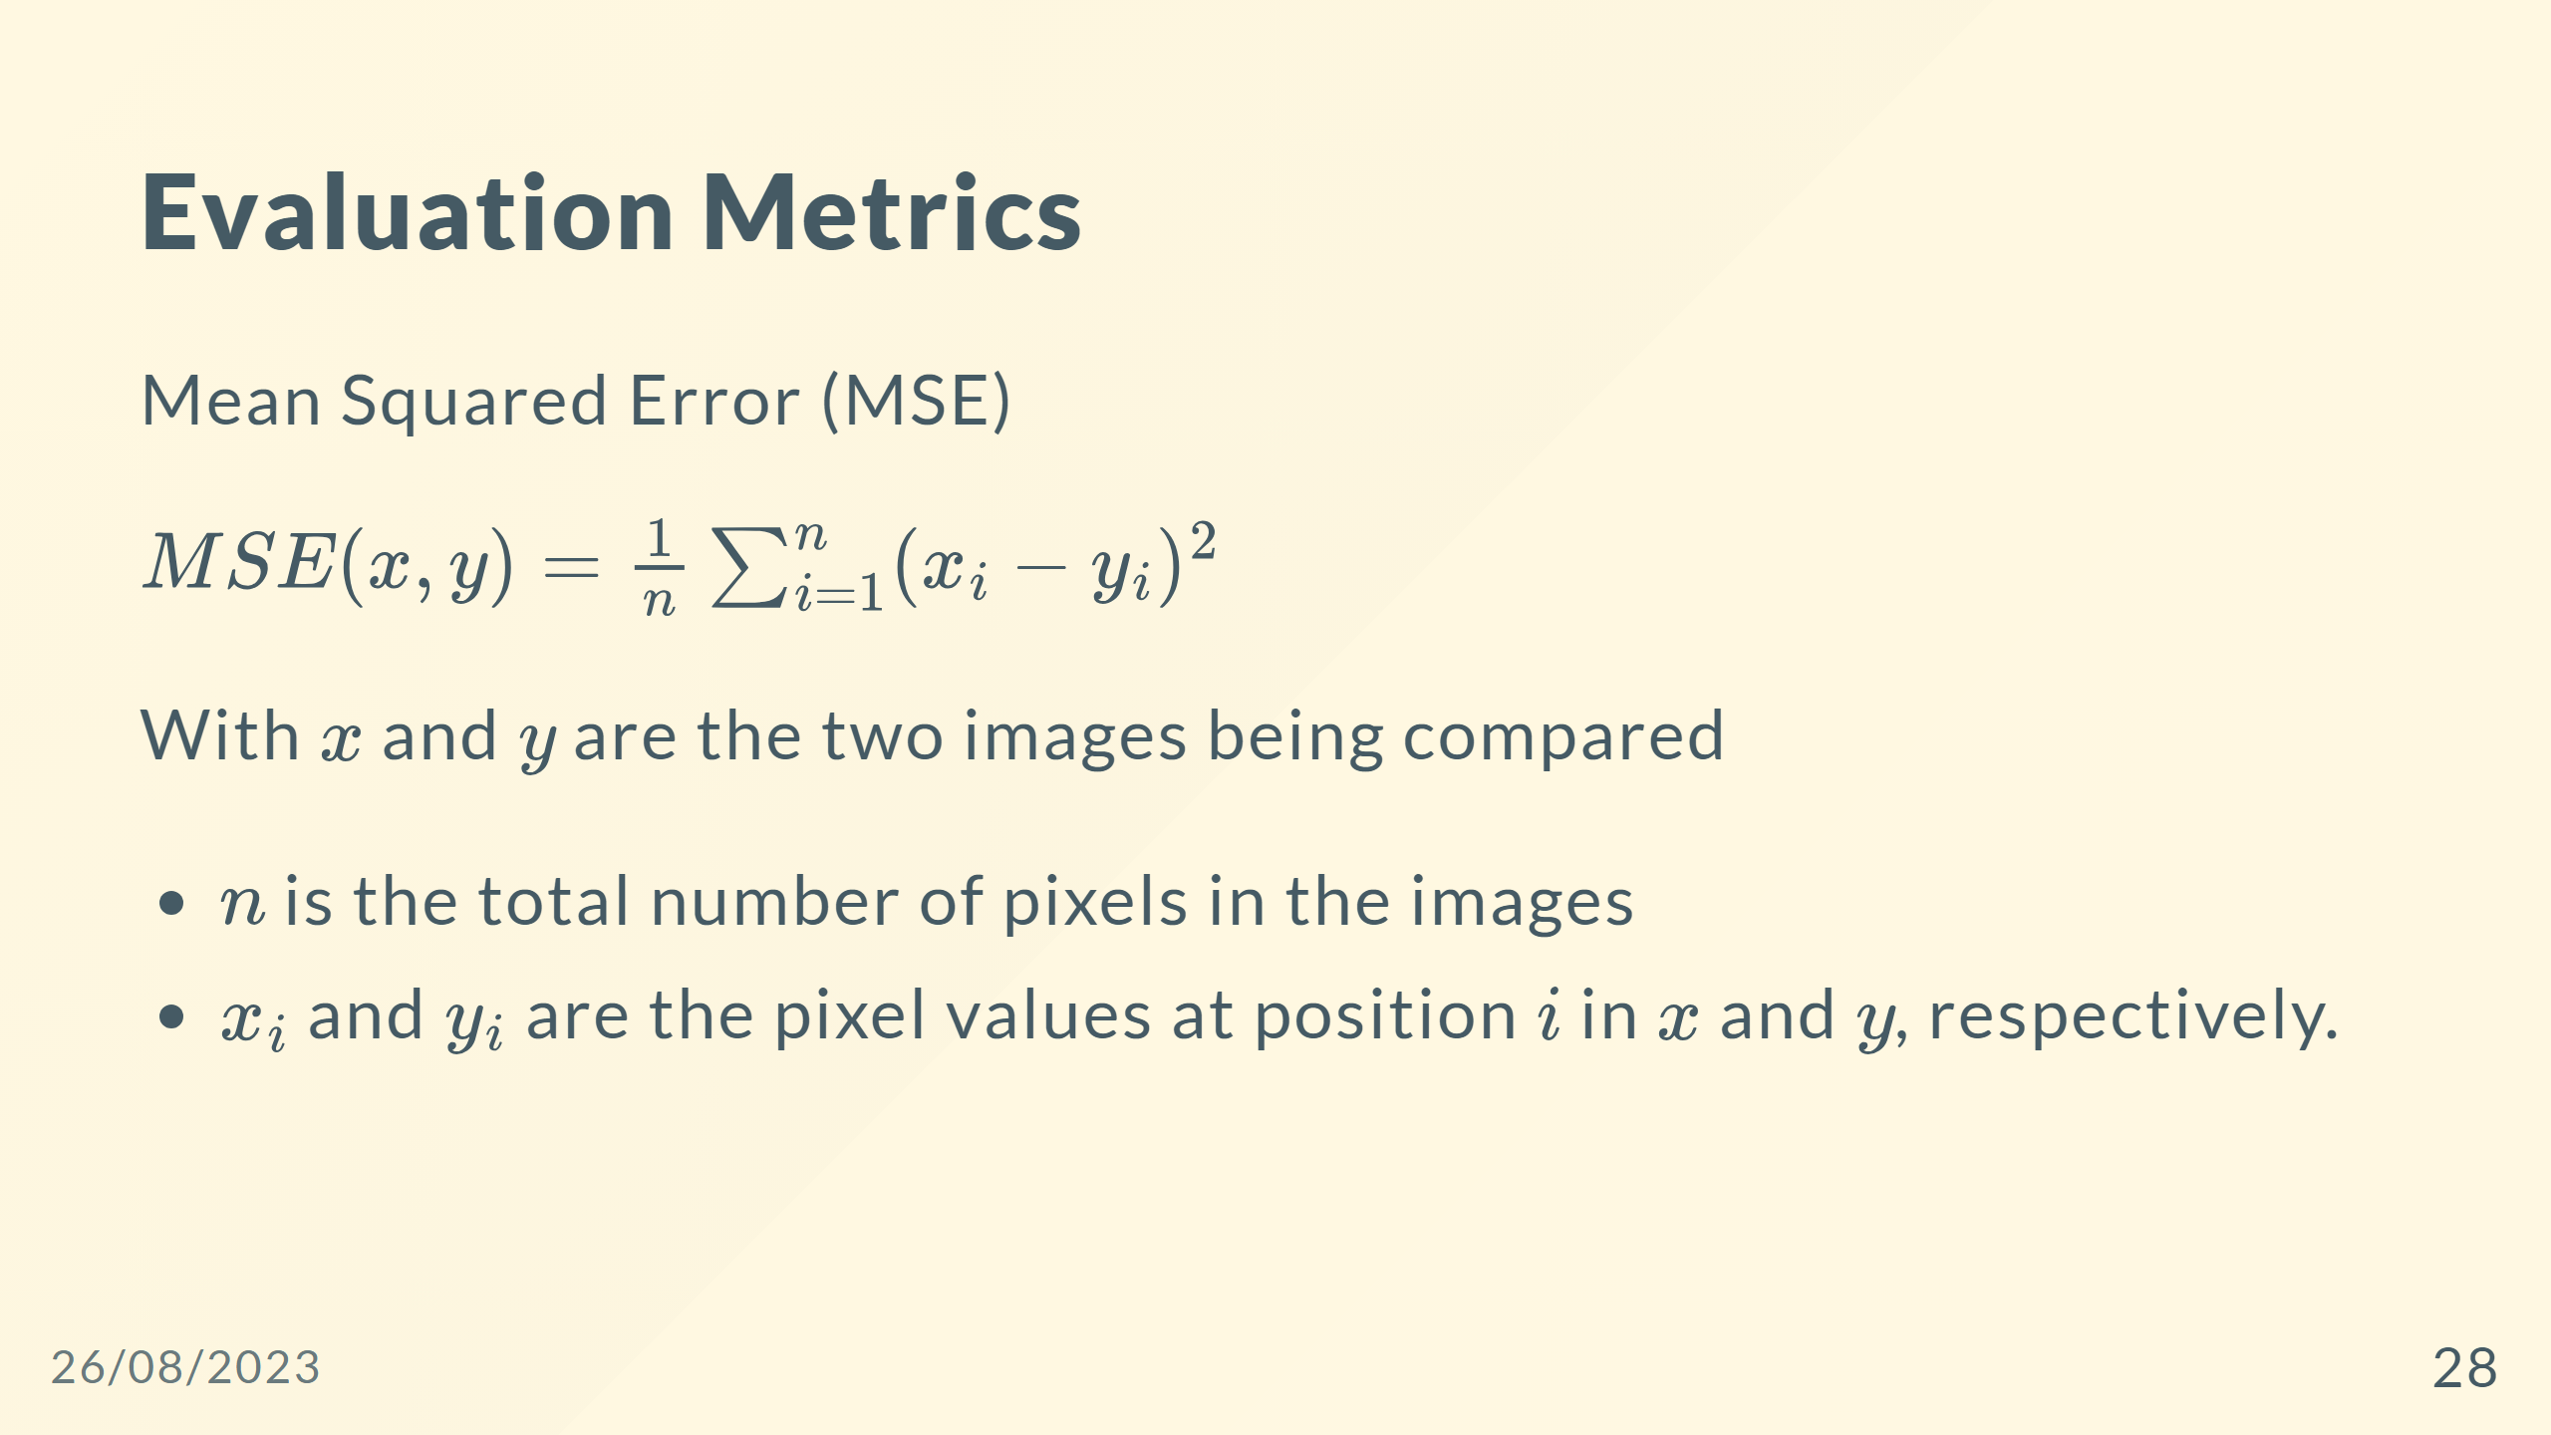

Slide 29
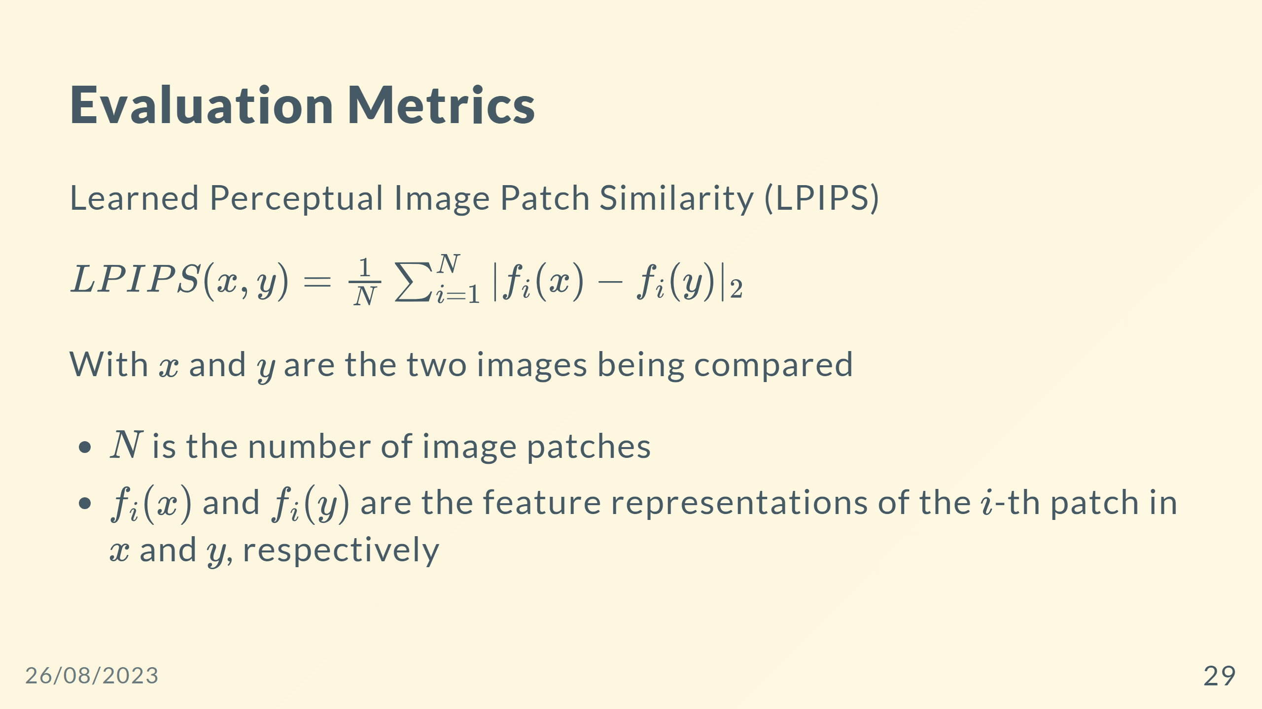

Slide 30
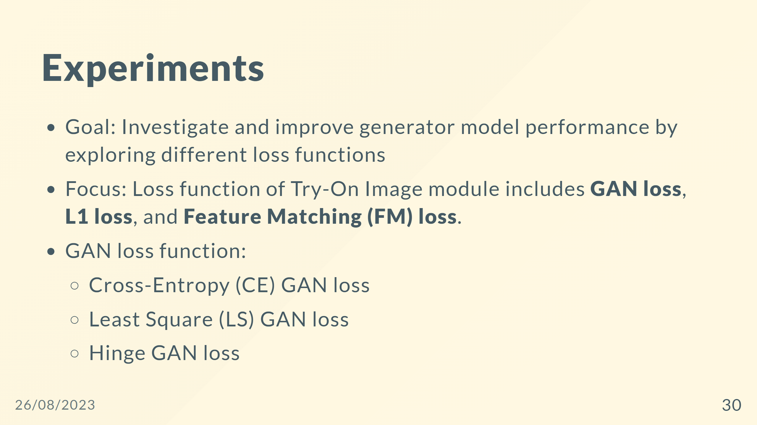

Slide 31
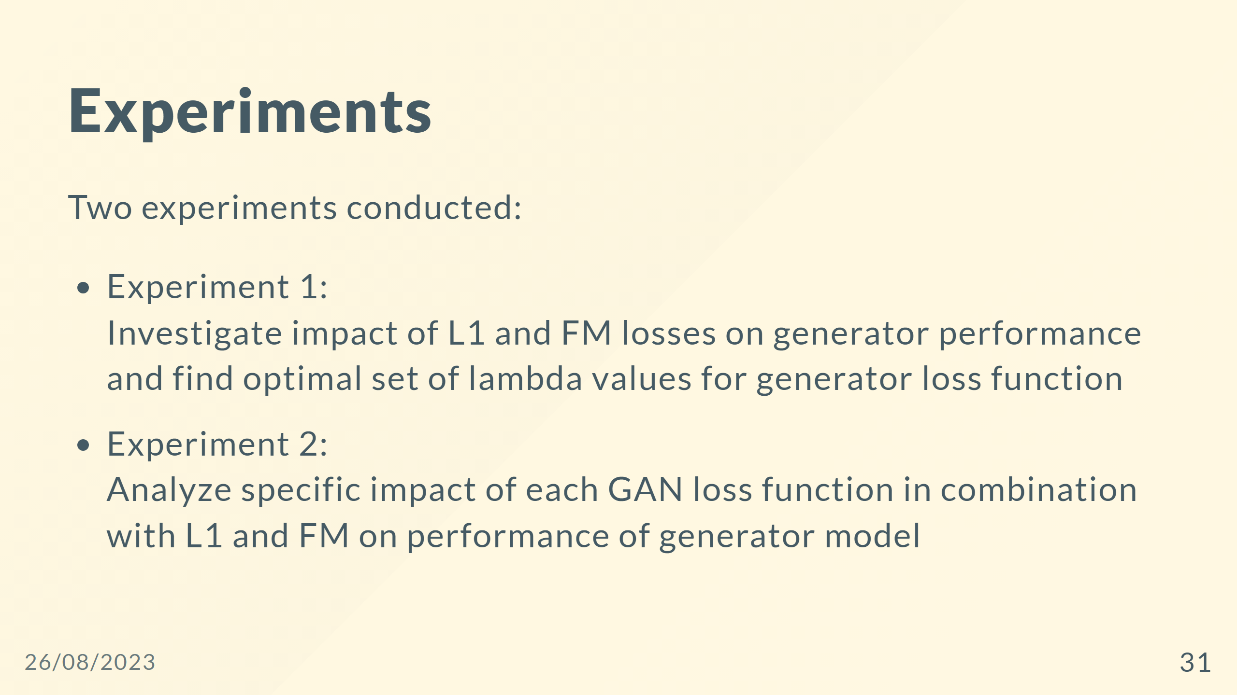

Slide 32
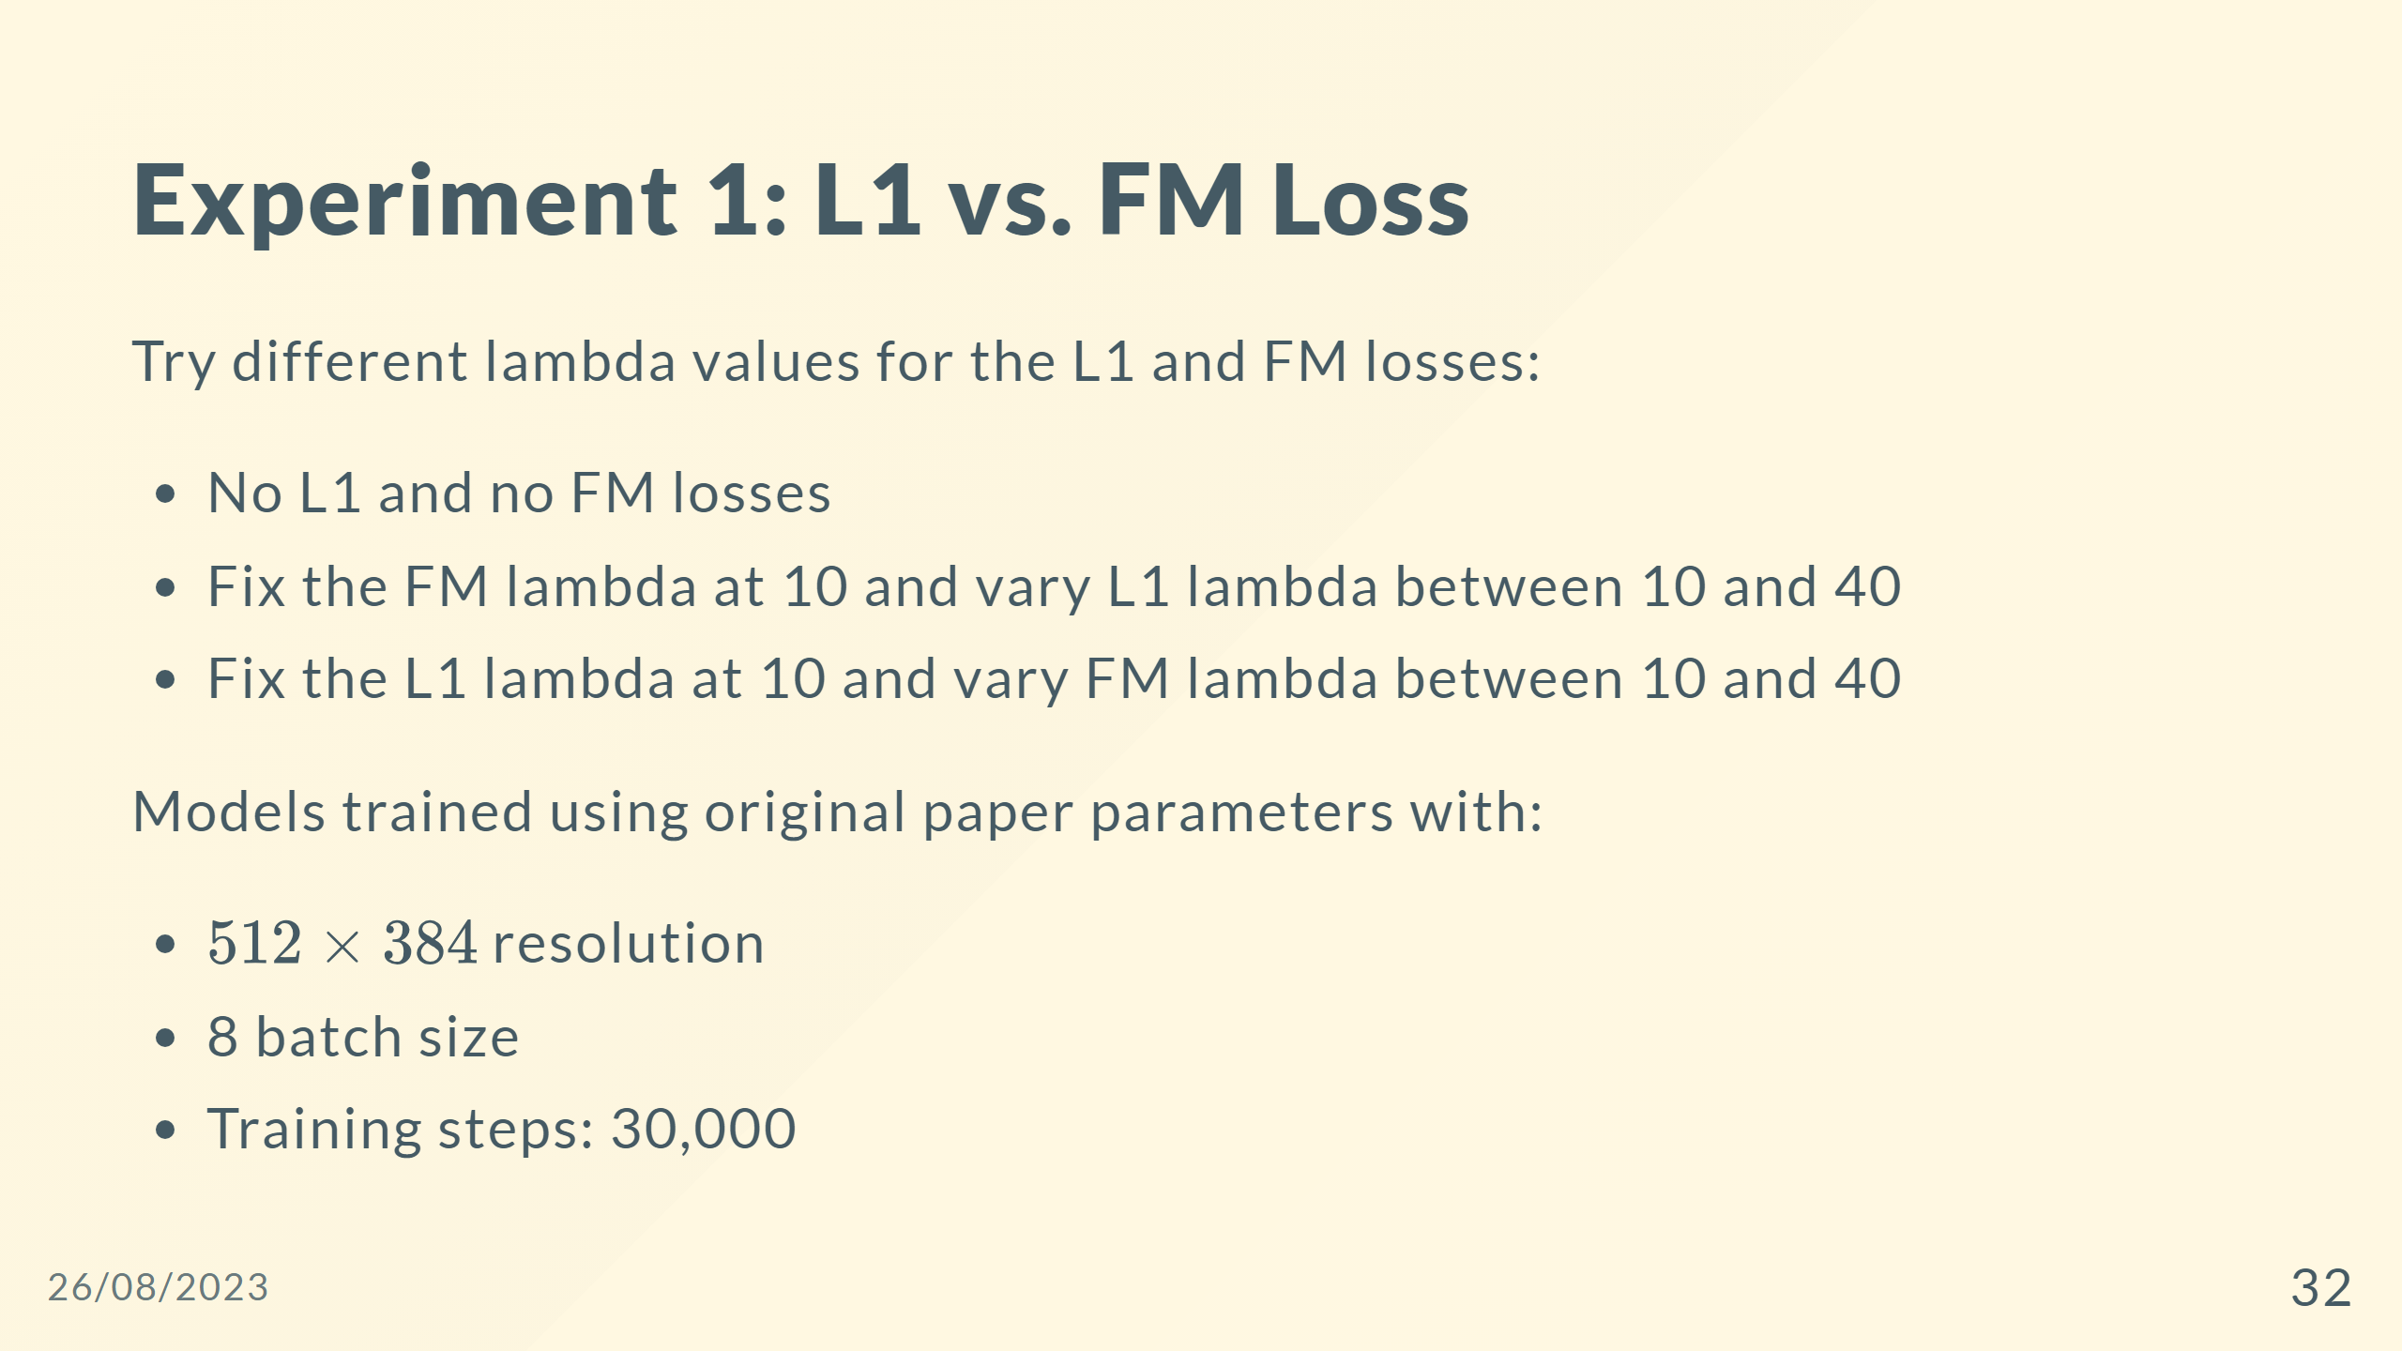

Slide 33
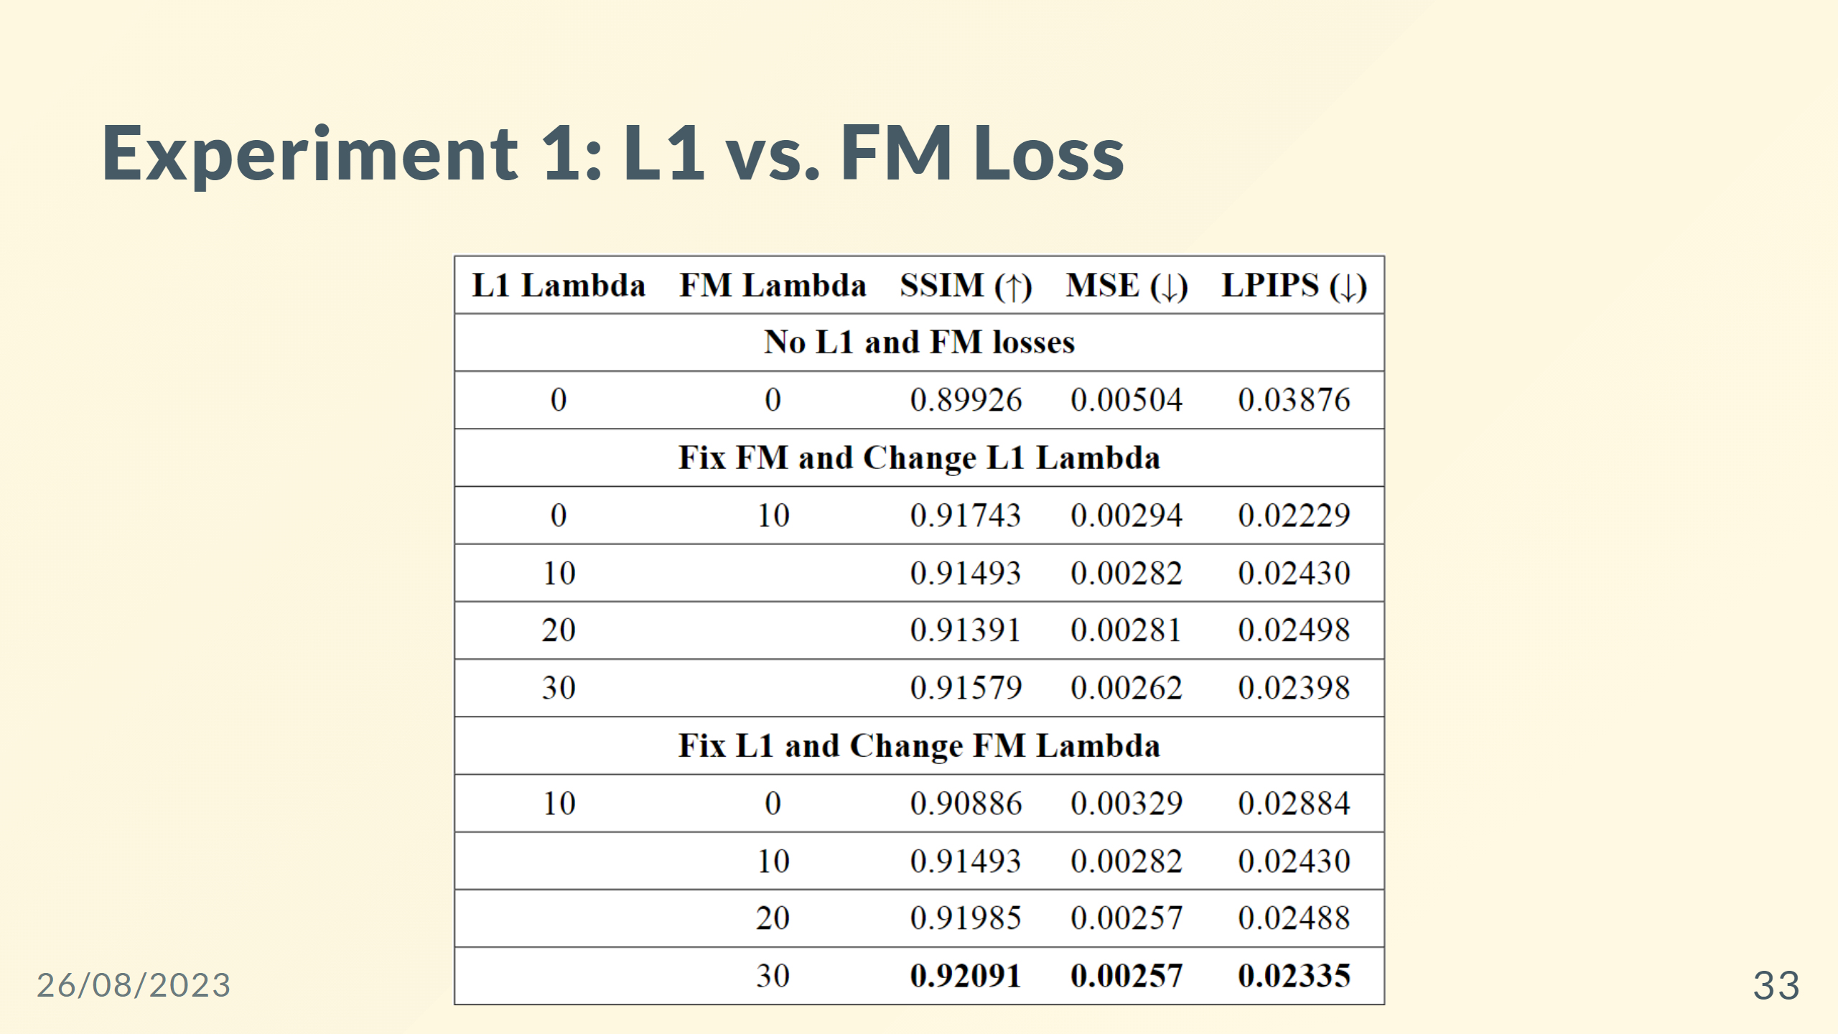

Slide 34
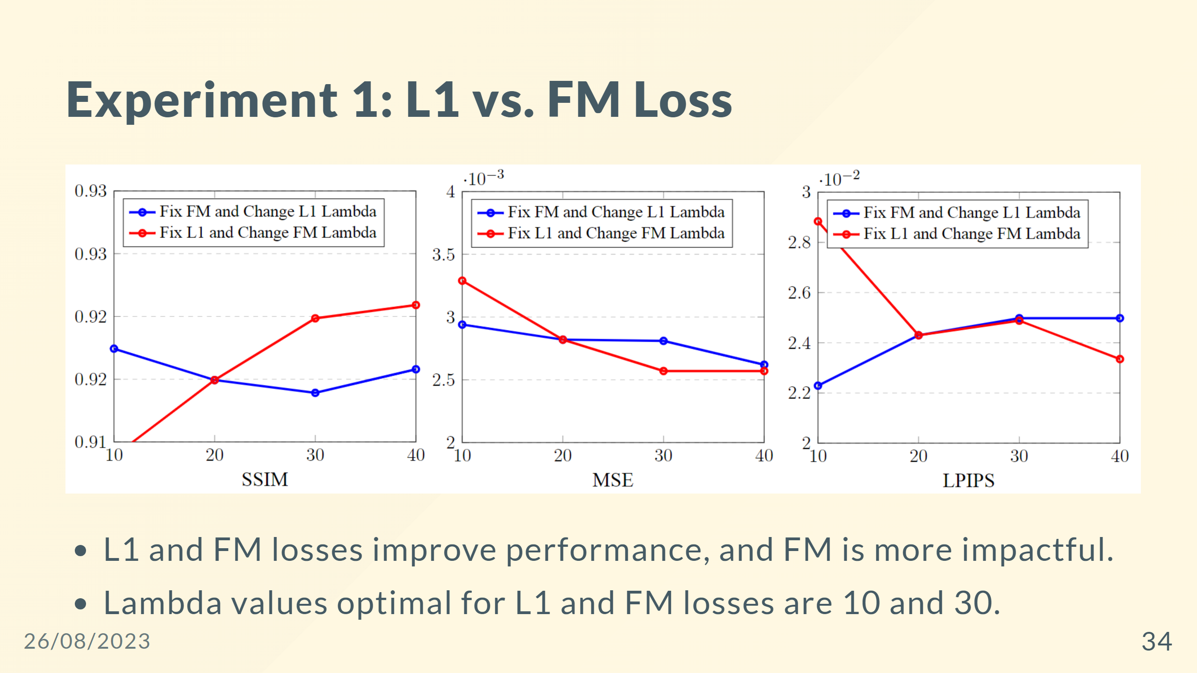

Slide 35
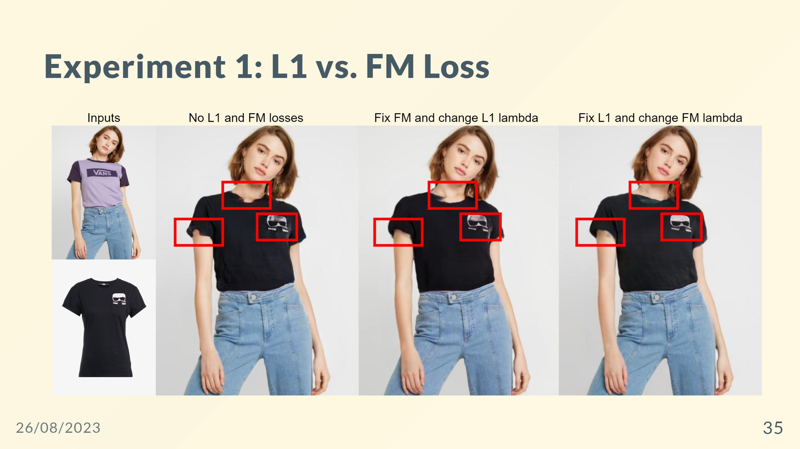

Slide 36
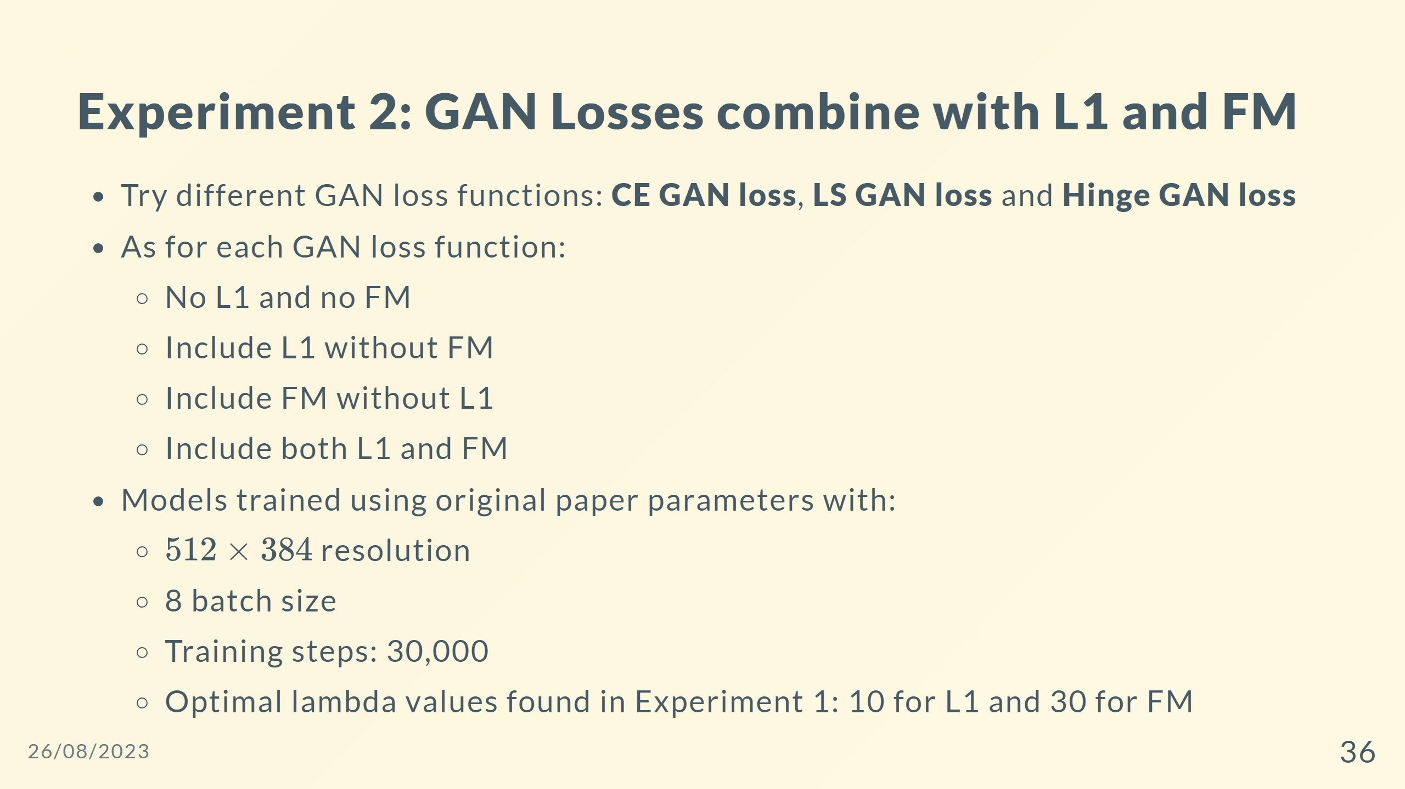

Slide 37
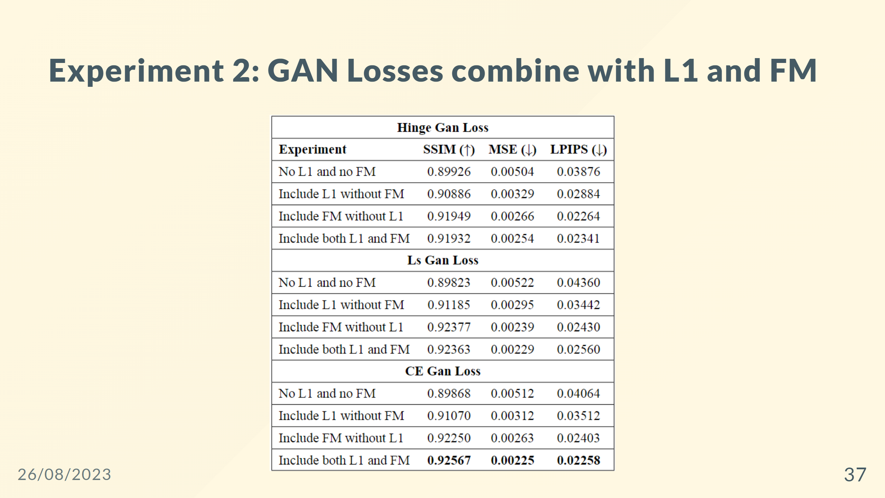

Slide 38
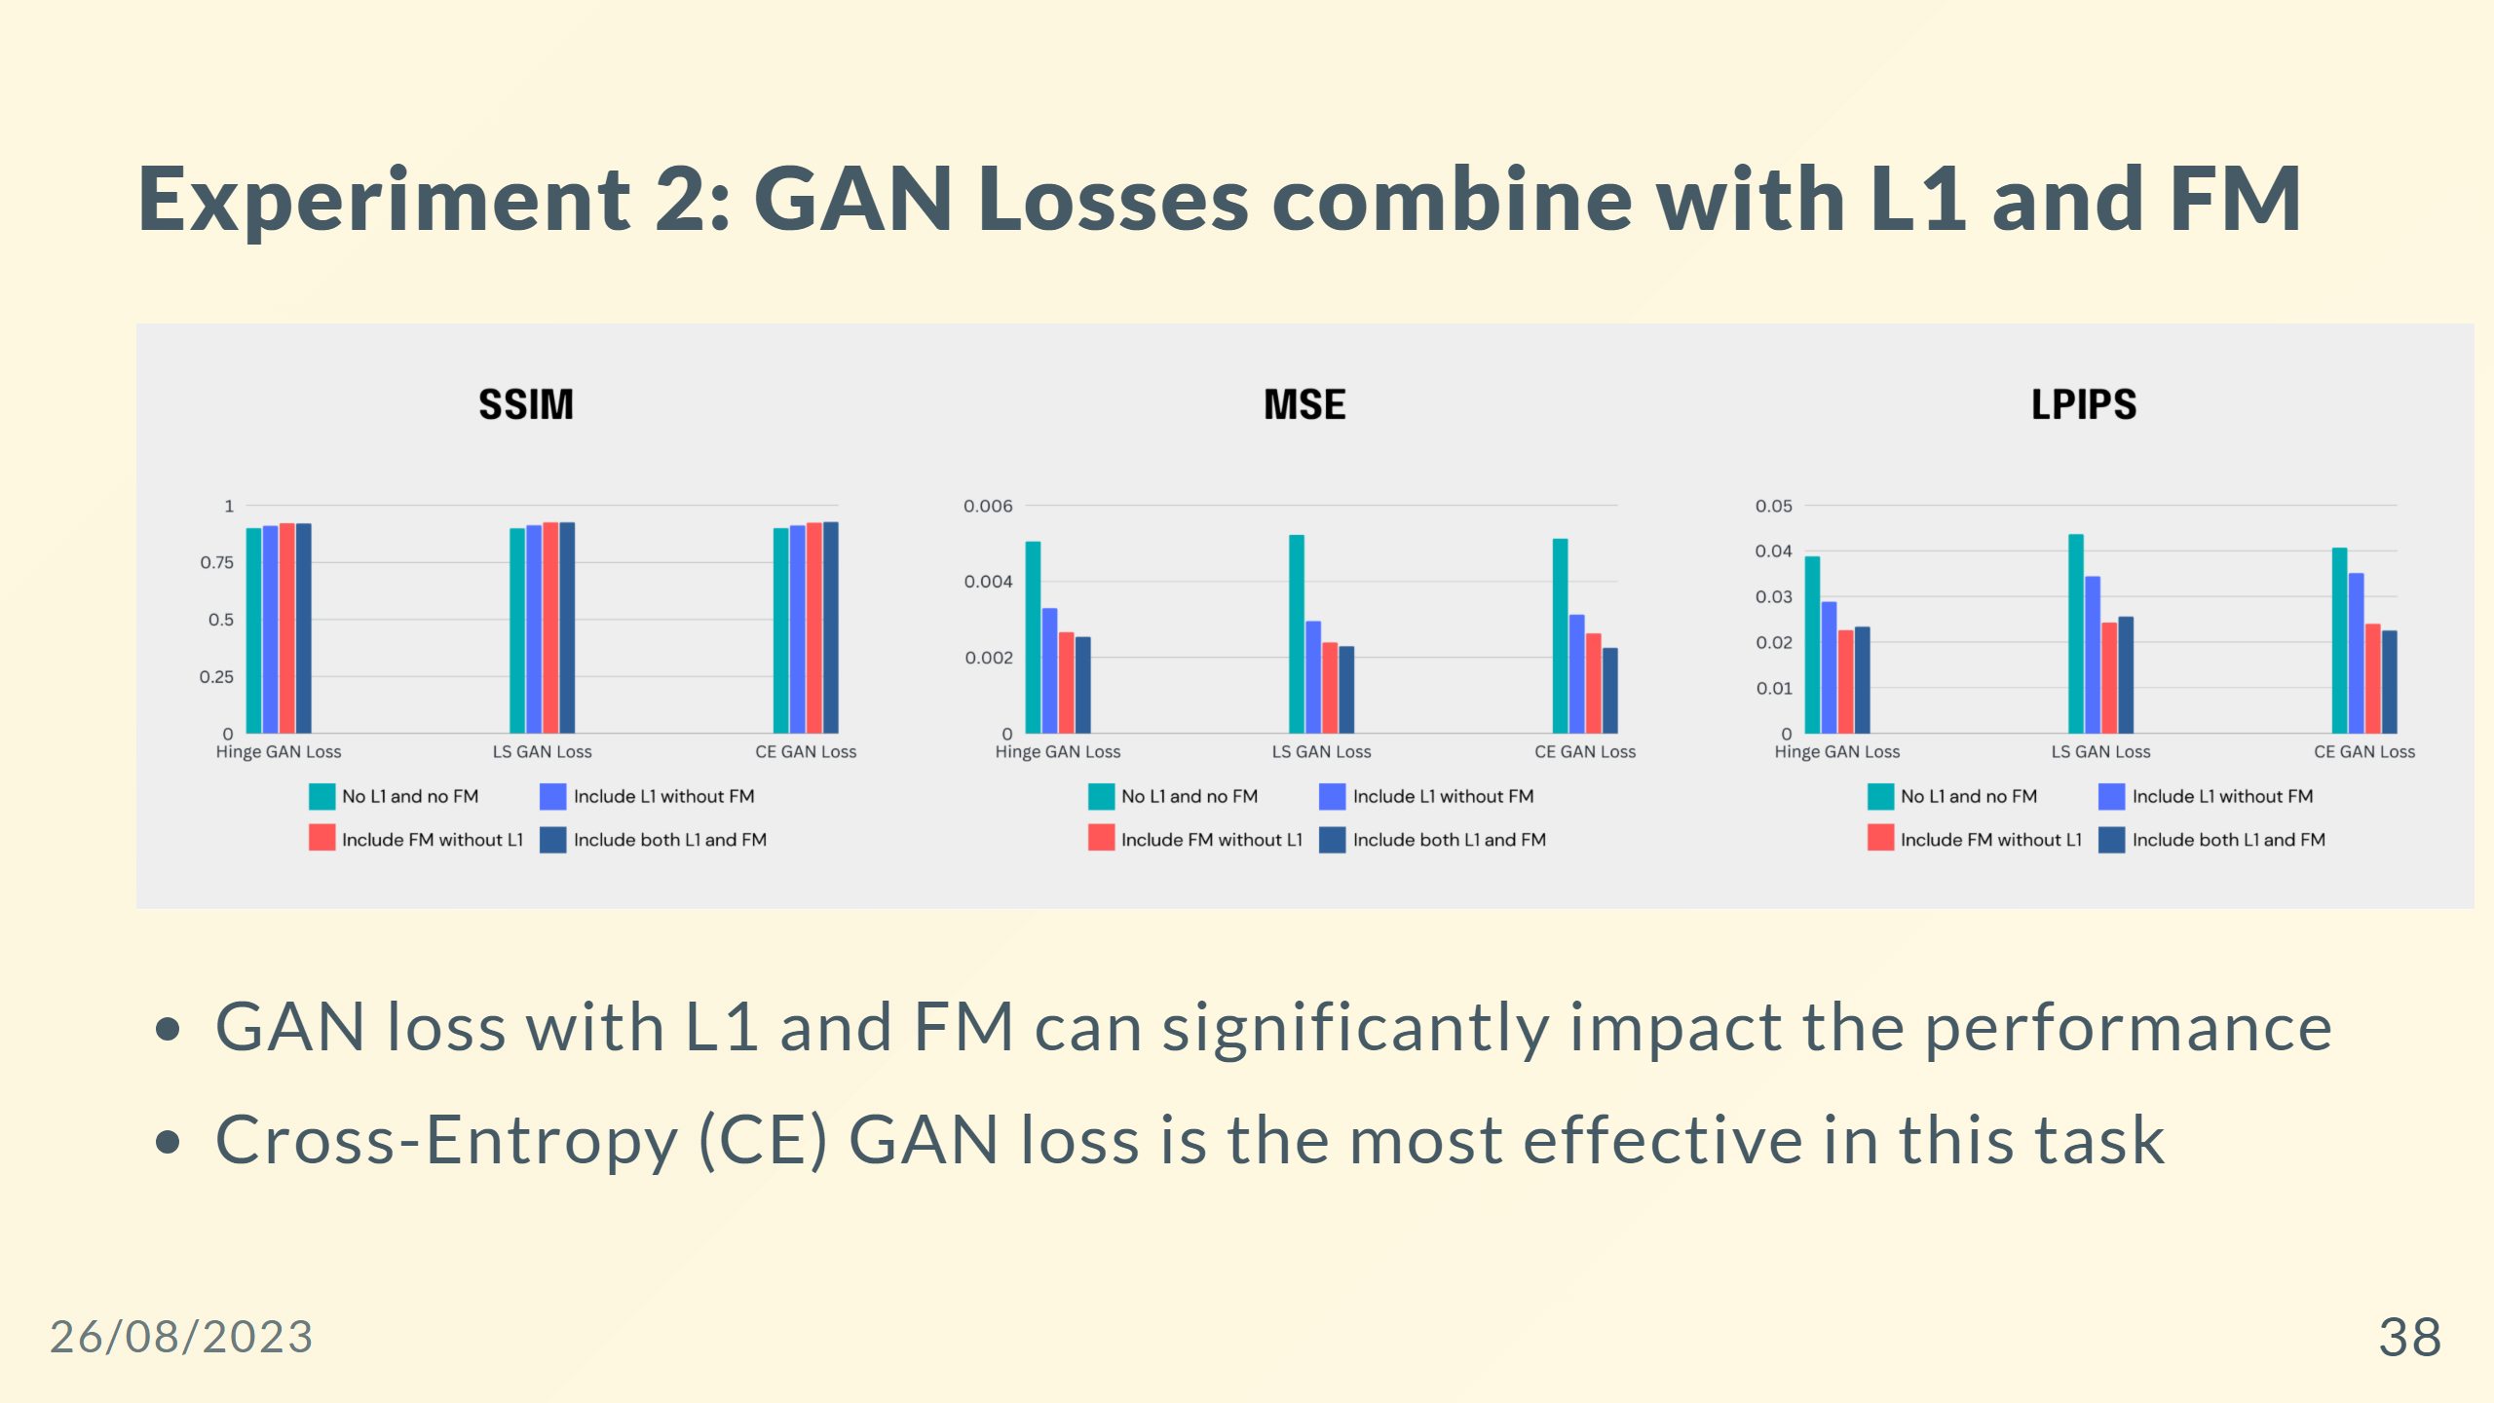

Slide 39
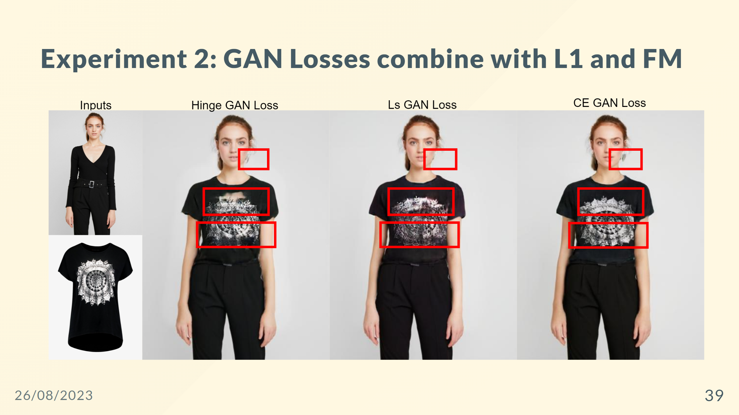

Slide 40
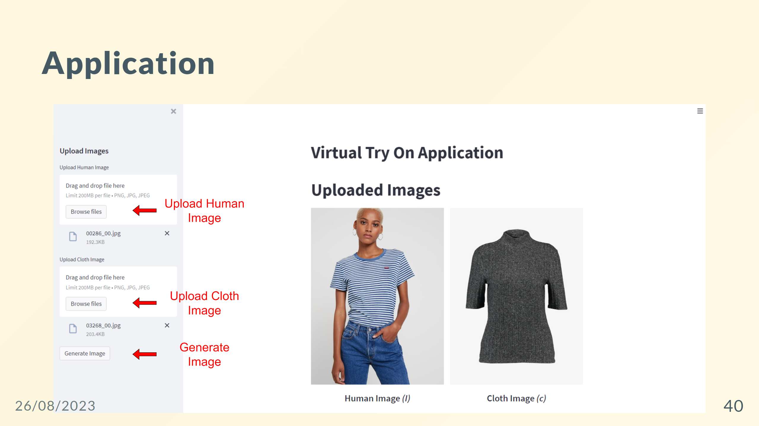

Slide 41
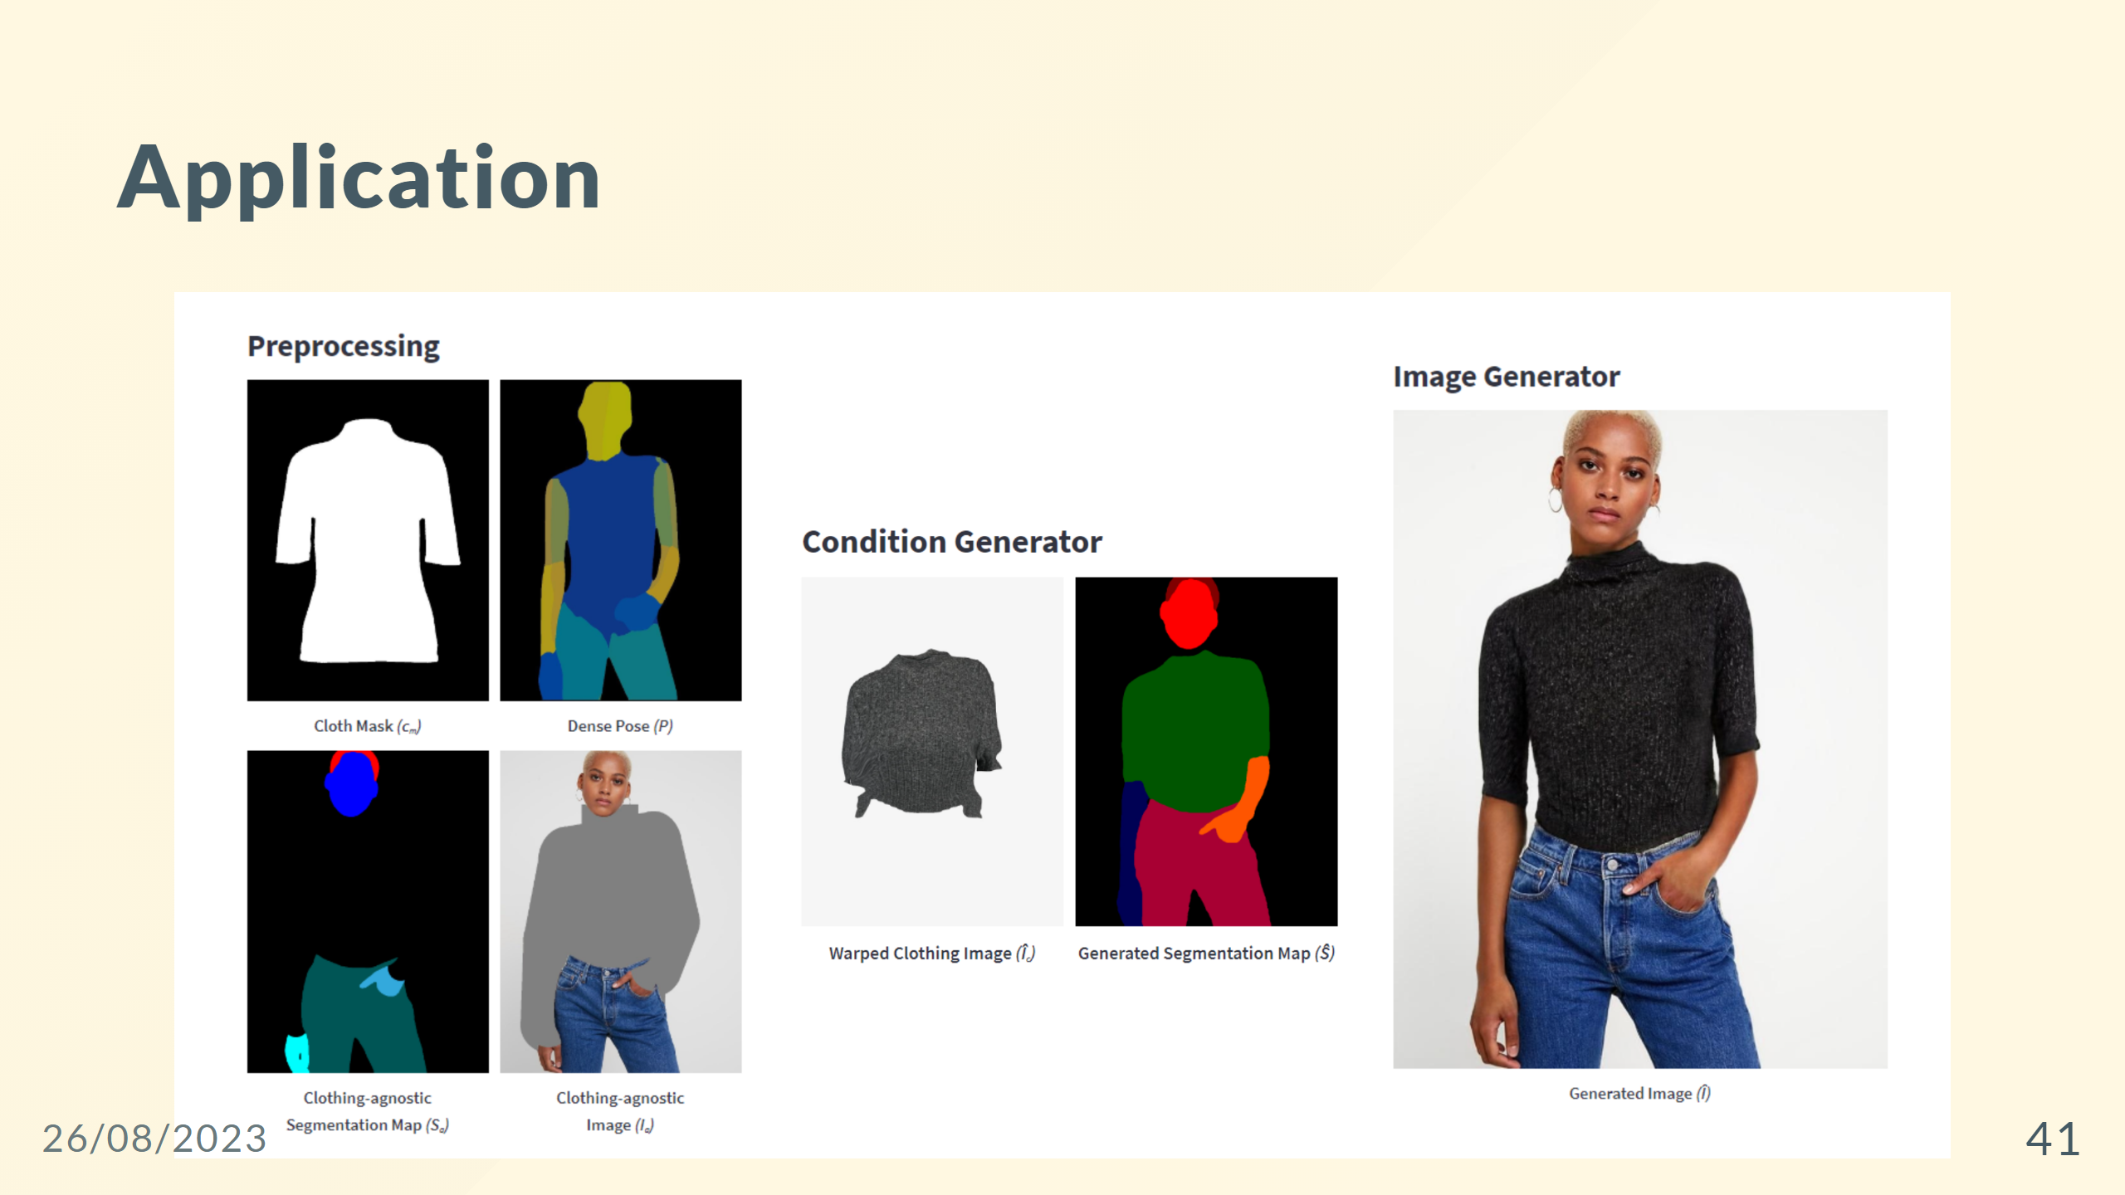

Slide 42
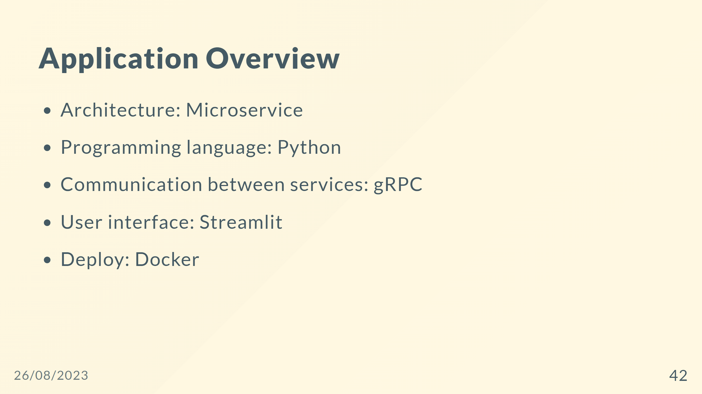
Notes:
![width:900 centernotop](app-overview.png)

Slide 43
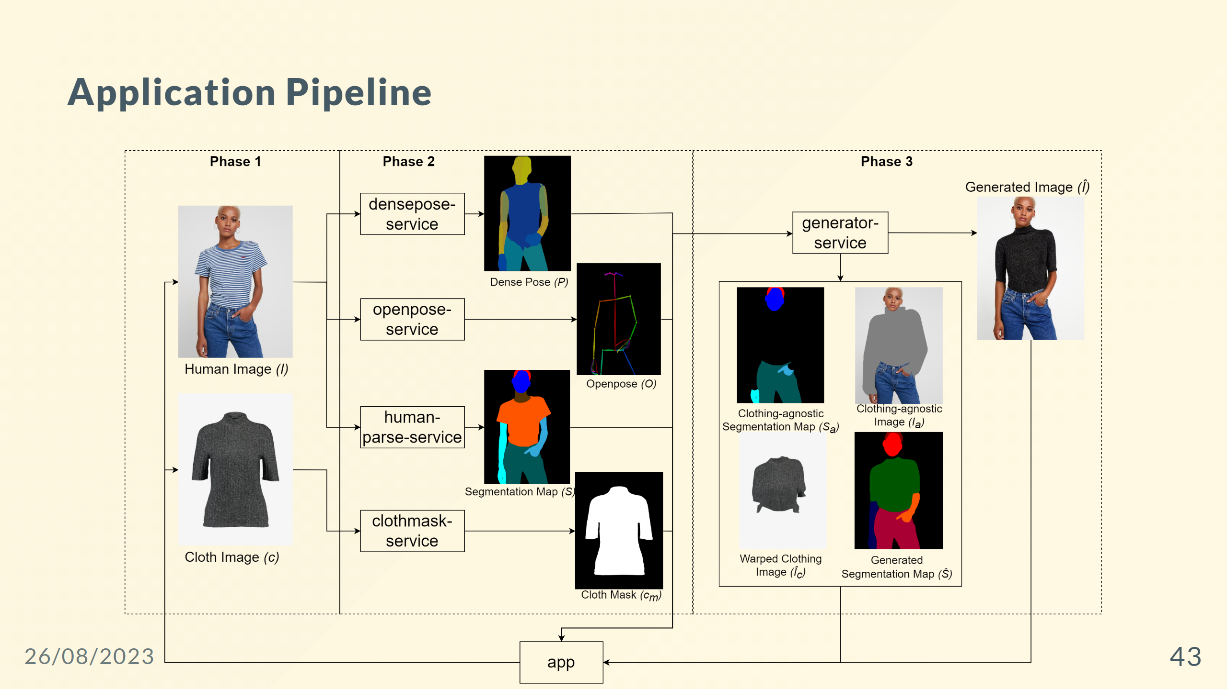

Slide 44
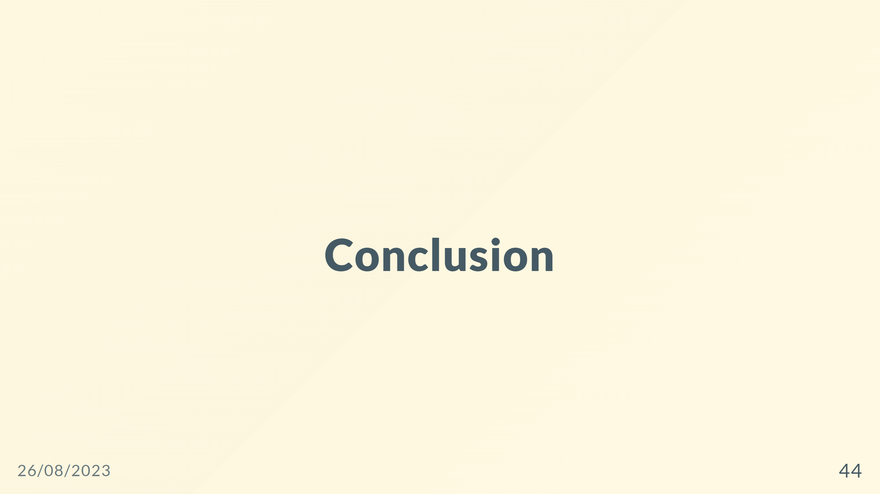

Slide 45
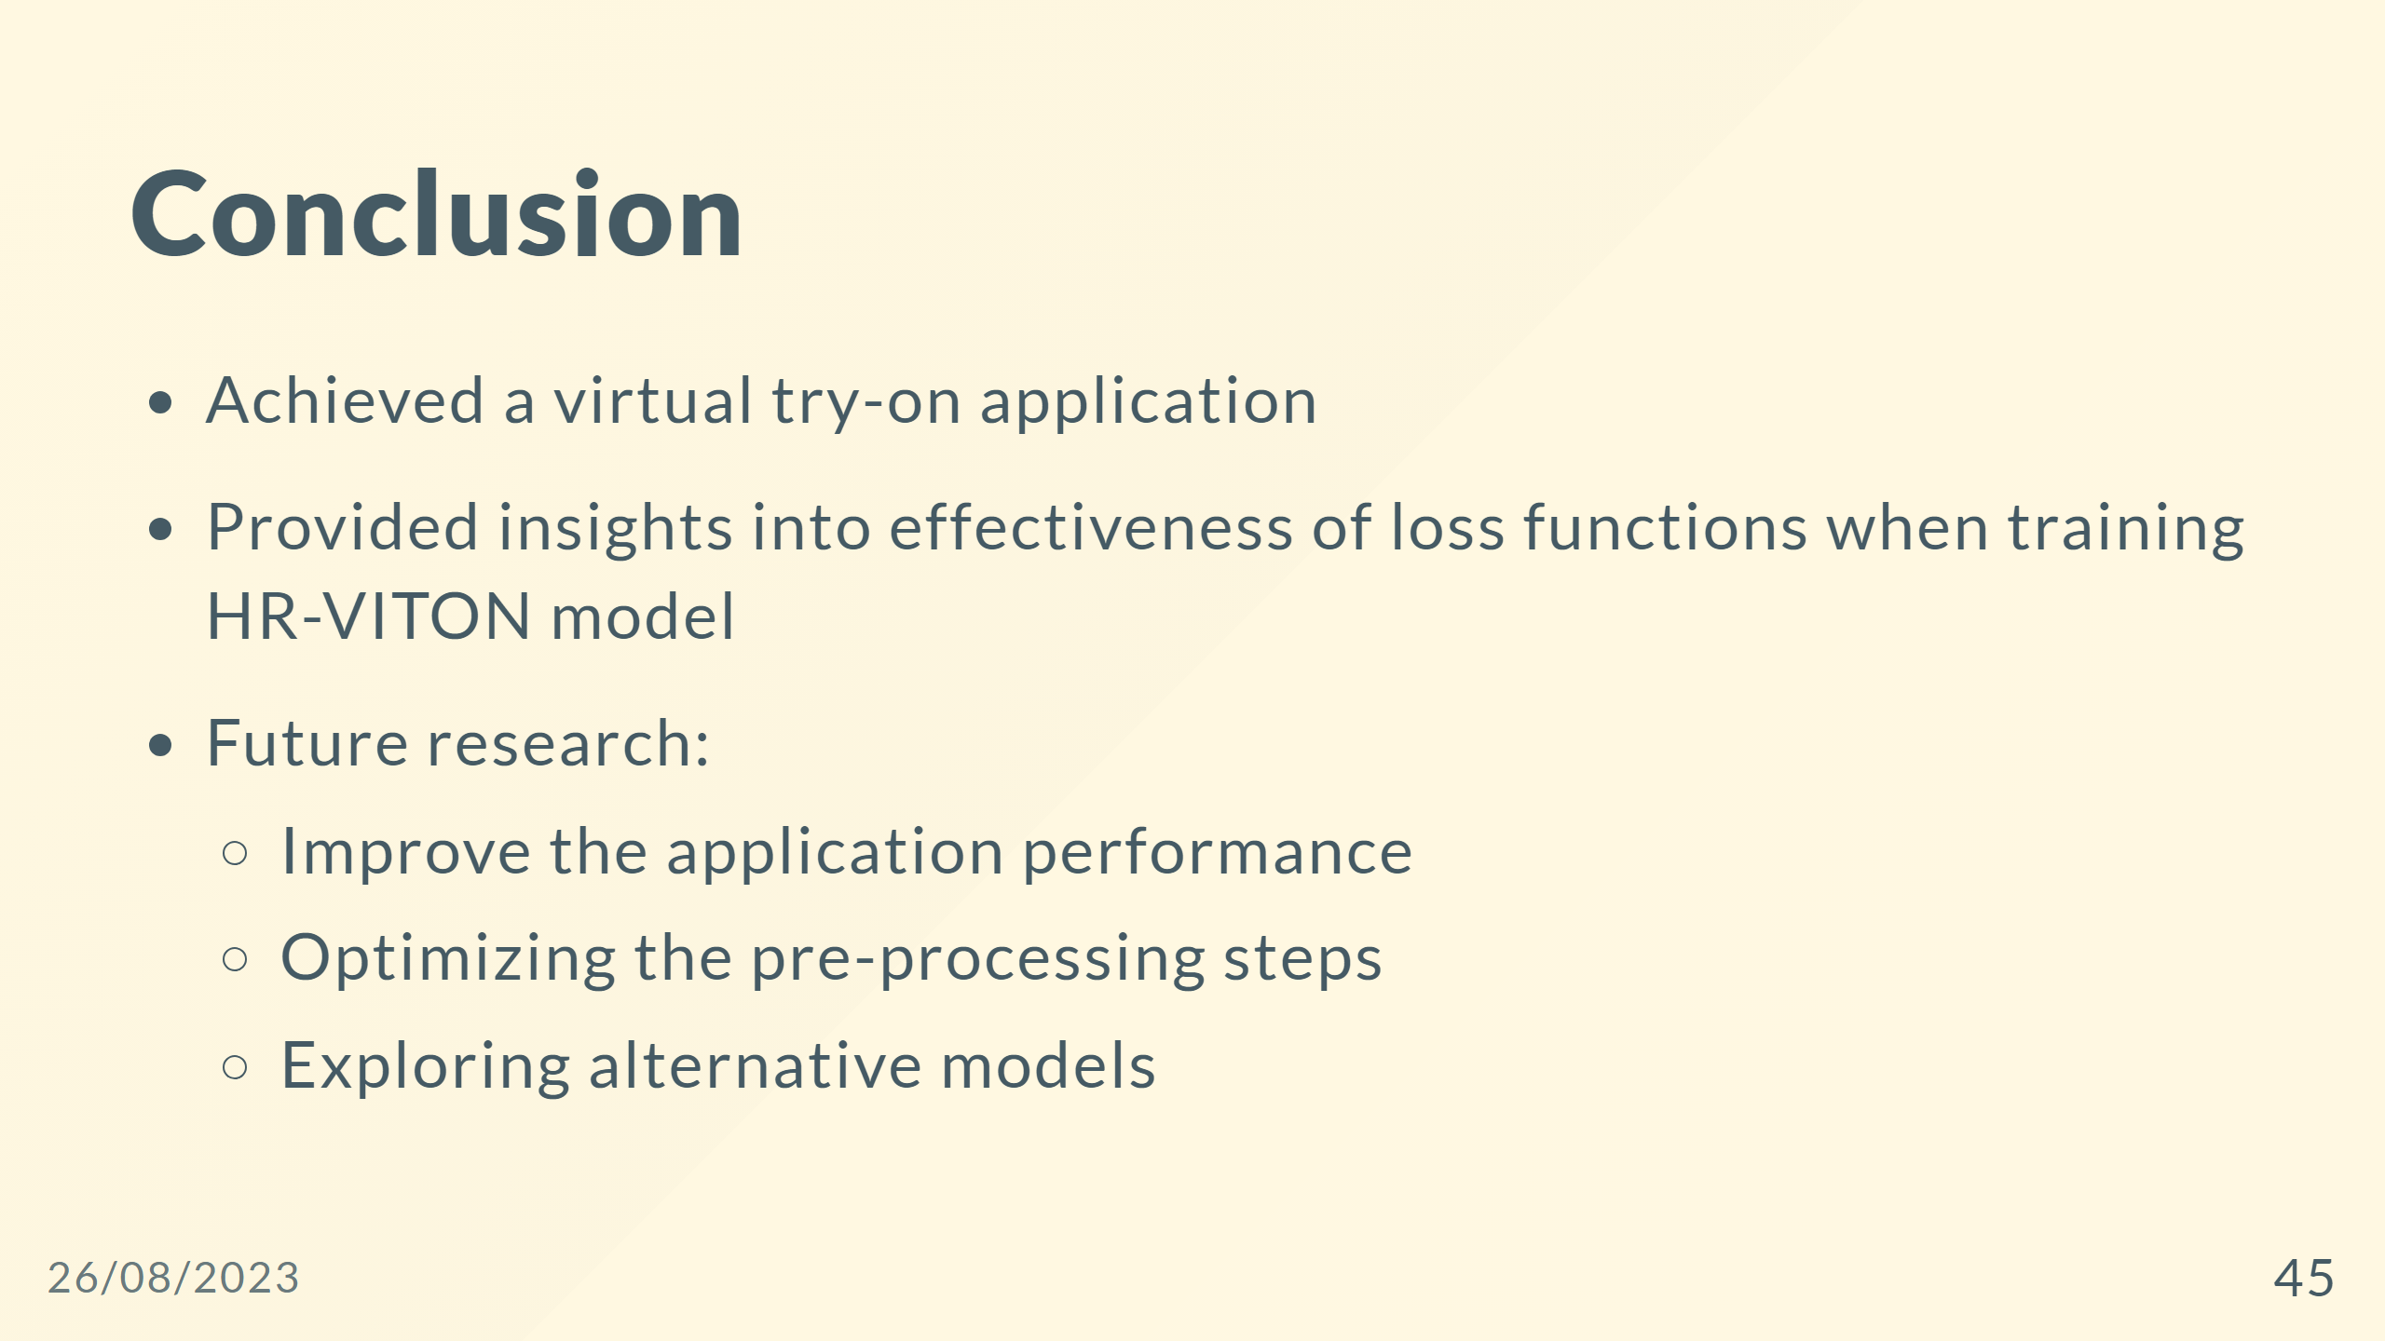

Slide 46


Slide 47
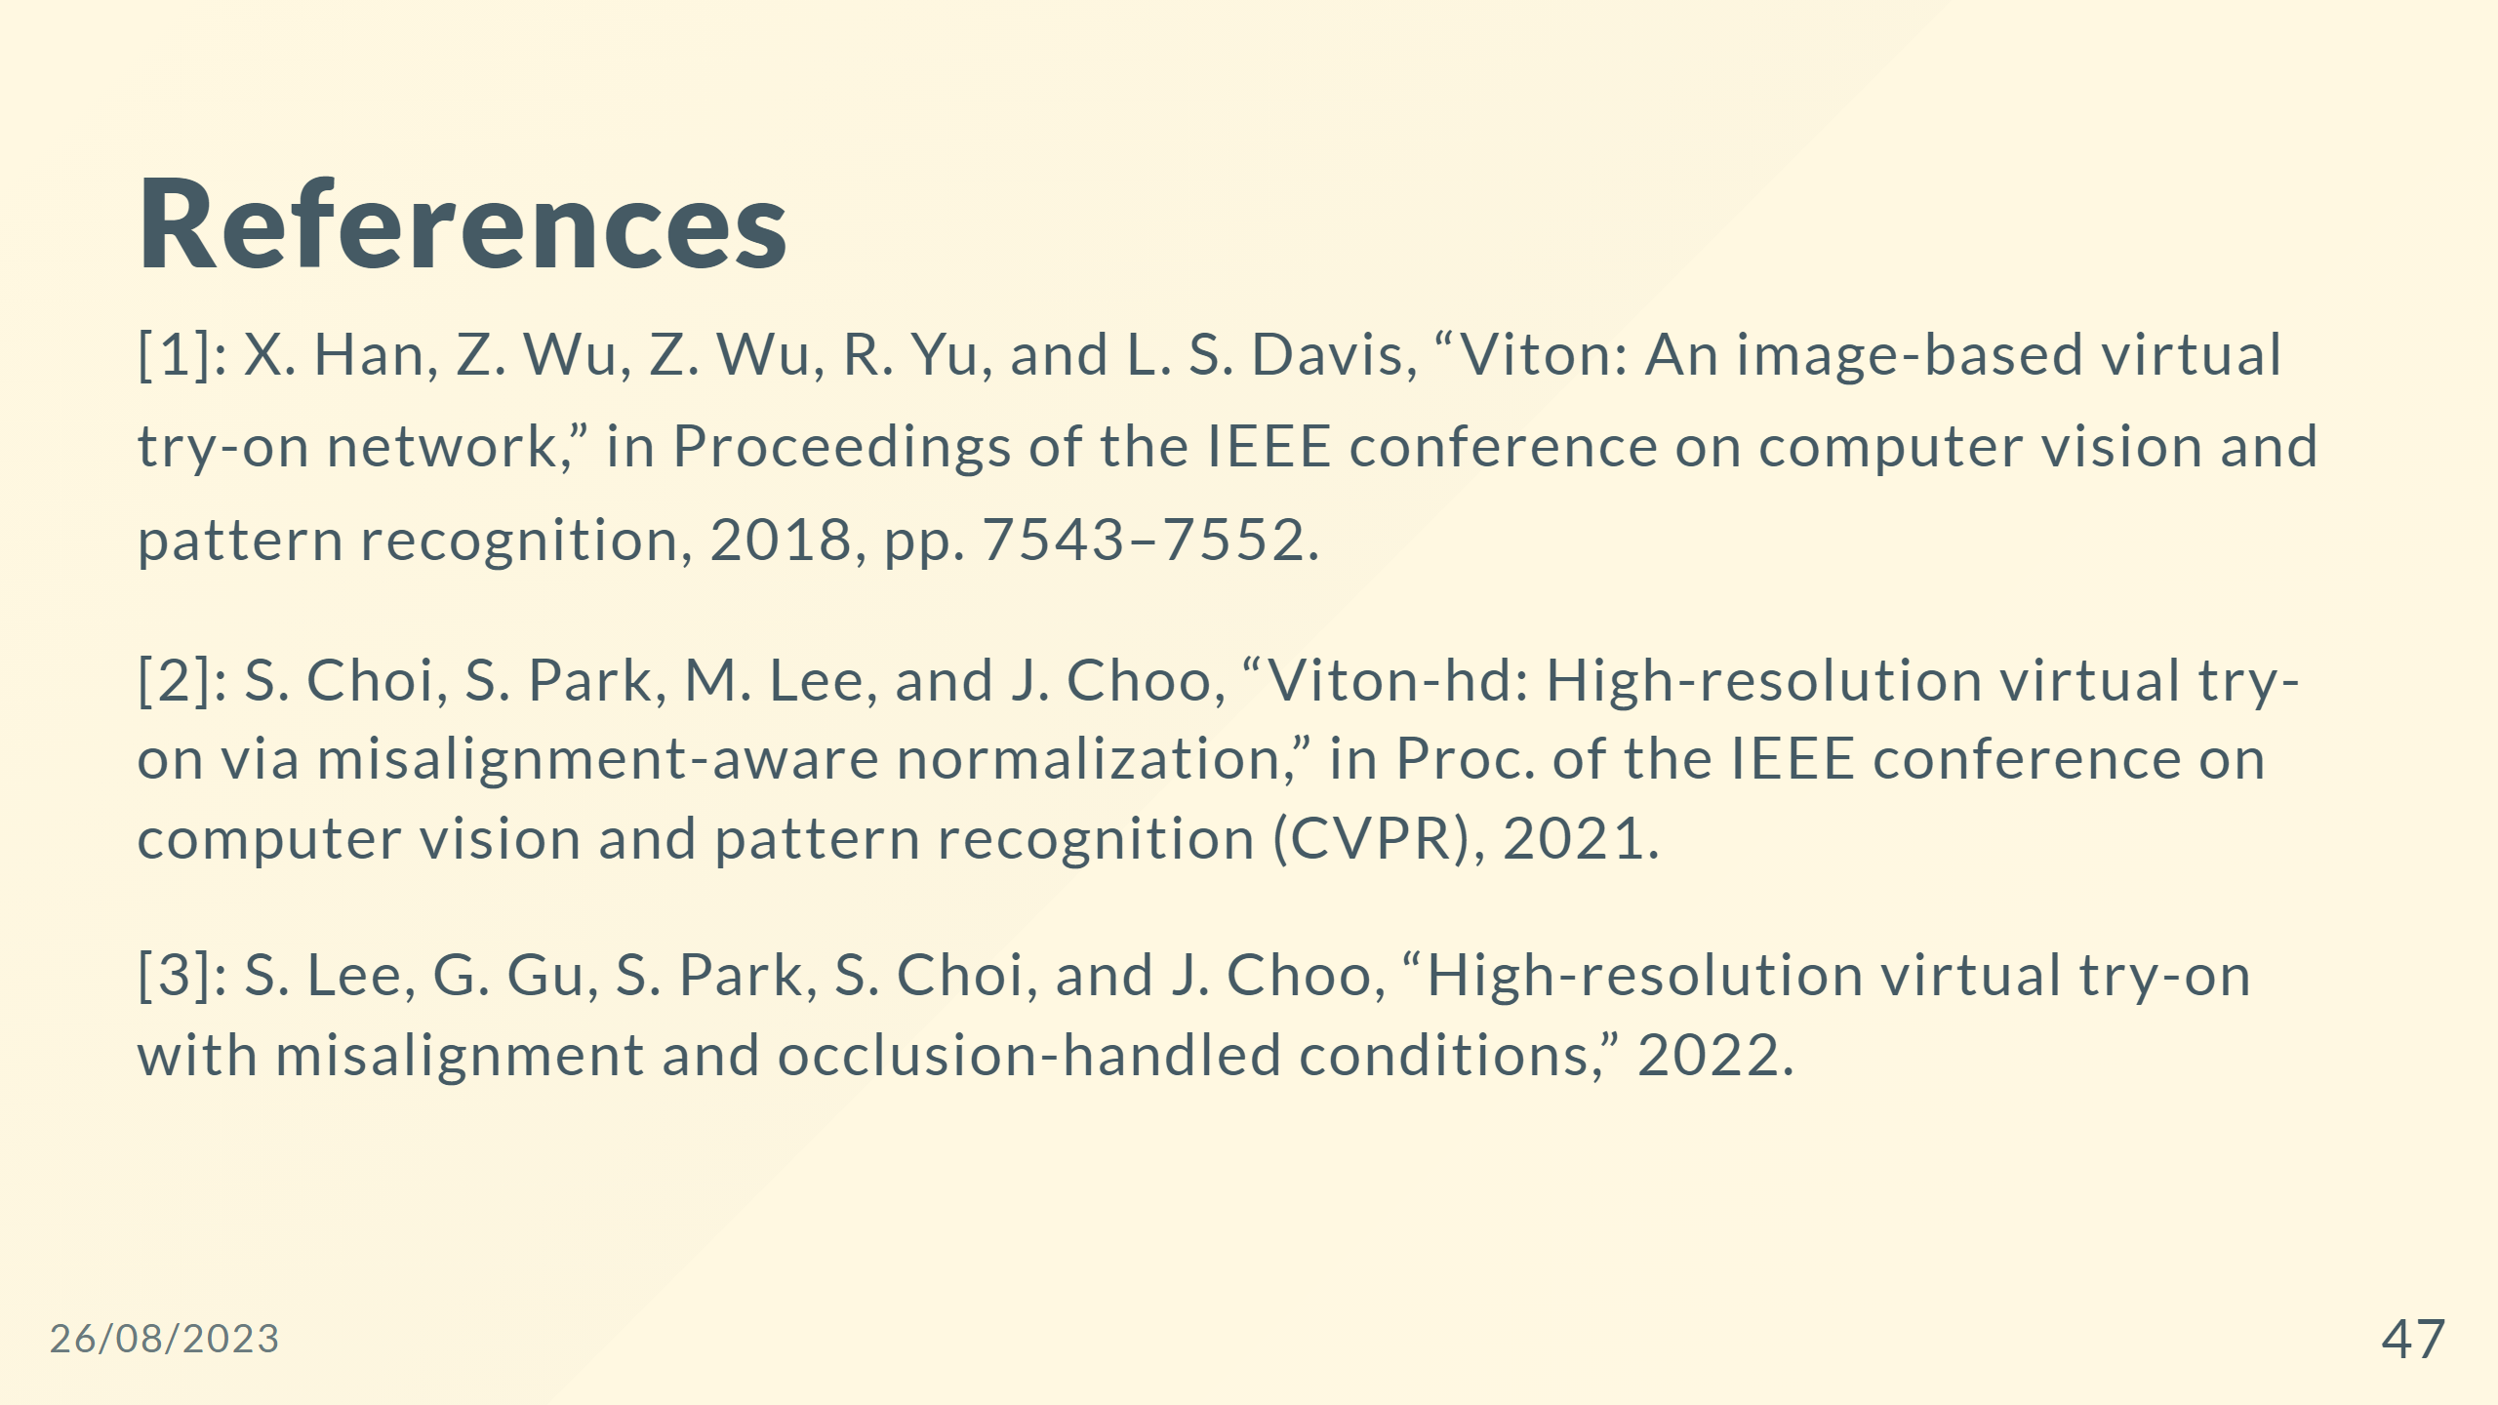

Slide 48
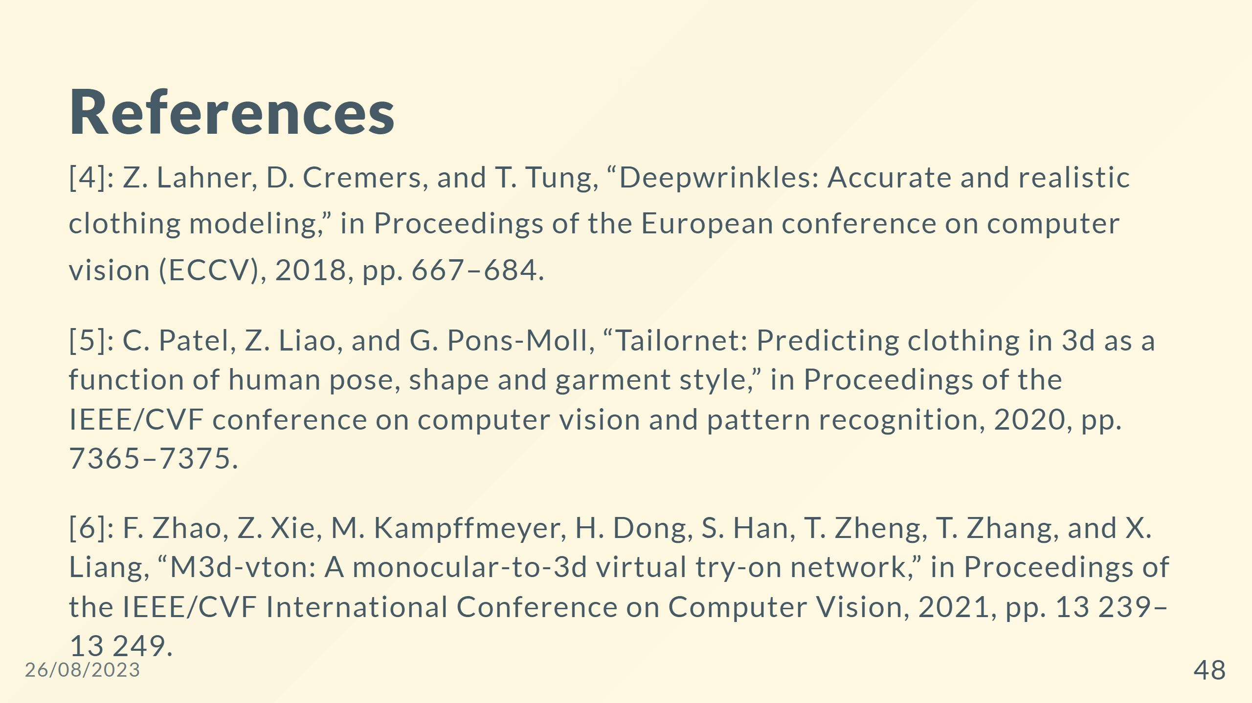

Slide 49
